Slide 1
This is the version of “ELT and the Science of Happiness: Positive Psychology in the Language Classroom” that Marc Helgesen used at JETA in Yogyakarta, June 2014 .
© 2014 Marc Helgesen
May be used for non-commercial purposes in your English classes.
For other uses, contact marc: march@mgu.ac.jp
Most of the photos are from clipart.com and are used with permission.

Slide 2
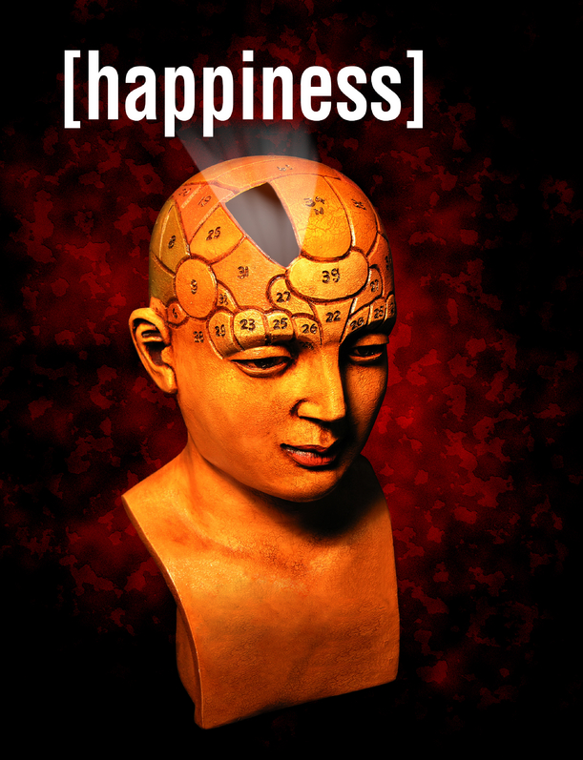

io
S
ELT & the science of
Marc Helgesen
JETA
June 2014
Notes:
B4 check – dancing bear/ laugh / timer
Excited, delighted.
Who are you?
Postive psychology

Slide 3
S
ELT & the science of
Positive
psychology
in the
language classroom
Notes:
Excited, delighted.
Who are you?
1st part: What is Positive psychology
2nd part: How connect that to ELT – also language and cross cultural connections.
Then a break and “Happiness 2.0”
You may think: Wait. Have to teach speaking, listening, reading, and writing? Now I’m responsible for happiness.
Not really. It can be a tool. But any teaching… (next slide)

Slide 4
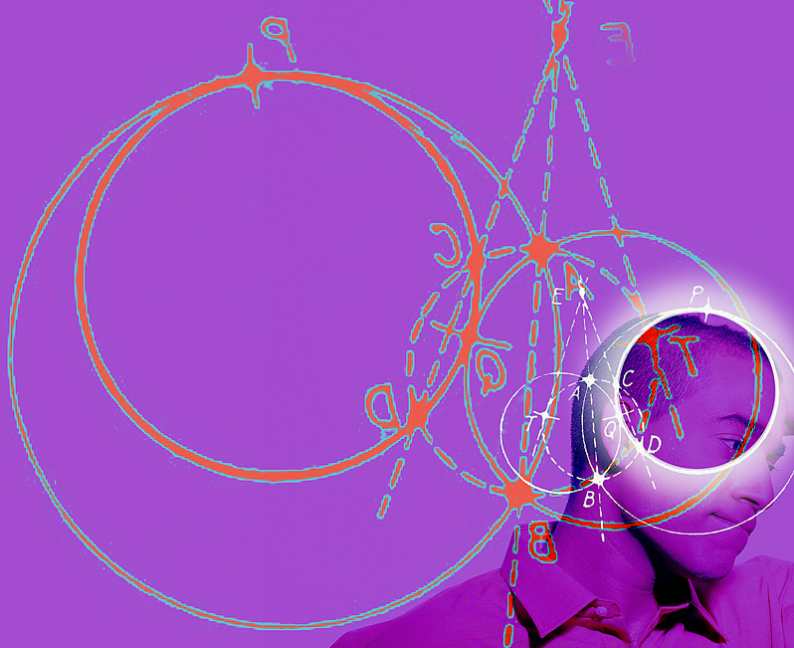
Educational
psychology
Notes:
Share some insight from positive psychology and can inform our teaching.
Start: how does happiness work?

Slide 5
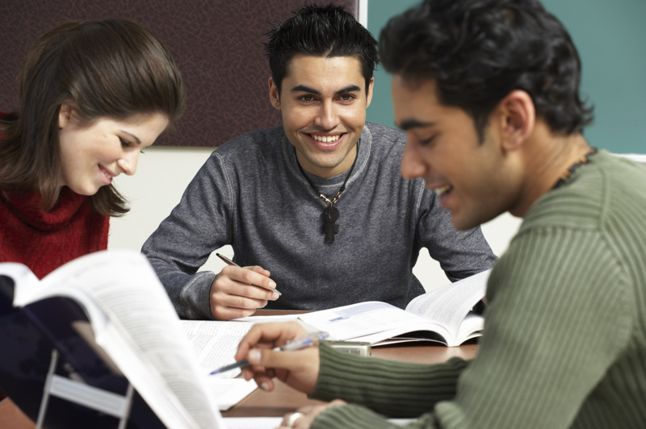

Happy students
Learn more
Work longer
More enthusiasm
http://www.centreforconfidence.co.uk/pp/overview.php?p=c2lkPTImdGlkPTAmaWQ9NA==
http://www.theage.com.au/ Don’t worry, be happy. May 8, 2006
Notes:
Learn more
Work longer at problem solving
Approach tasks with more enthusiasm.
http://www.centreforconfidence.co.uk/pp/overview.php?p=c2lkPTImdGlkPTAmaWQ9NA==
http://www.theage.com.au/ Don’t worry, be happy. May 8, 2006

Slide 6
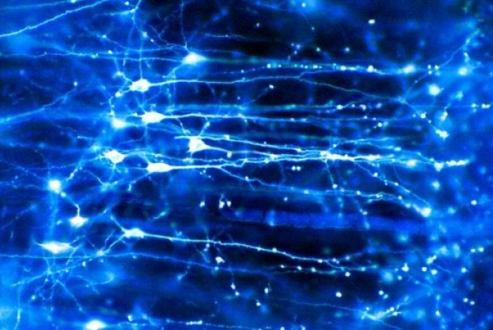
seritonin
Learning centers
Achor 2010
Notes:
Brain is full of chemical – serotonin, enDORFin, dopamine

Slide 7
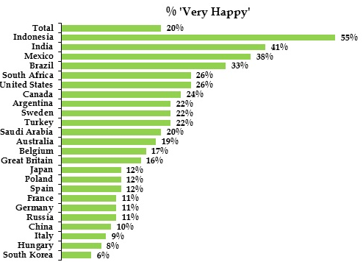



55%
26%
12%
Notes:
http://www.ipsos-na.com/news-polls/pressrelease.aspx?id=6400
Just got

Slide 8
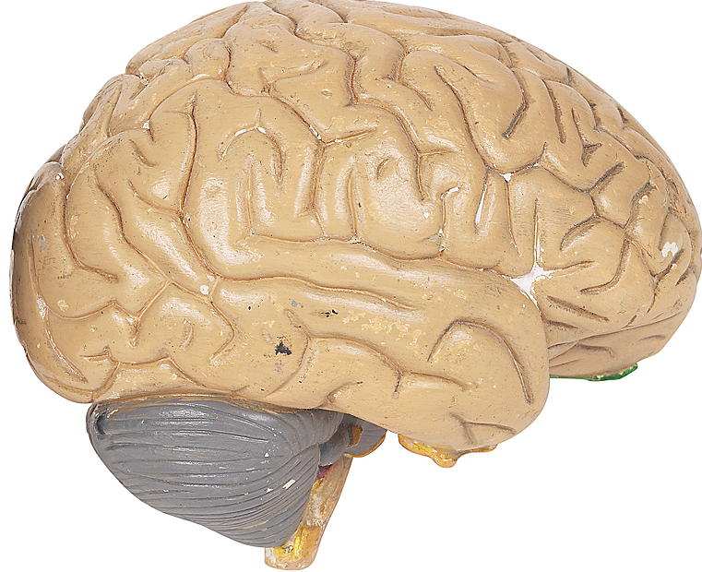
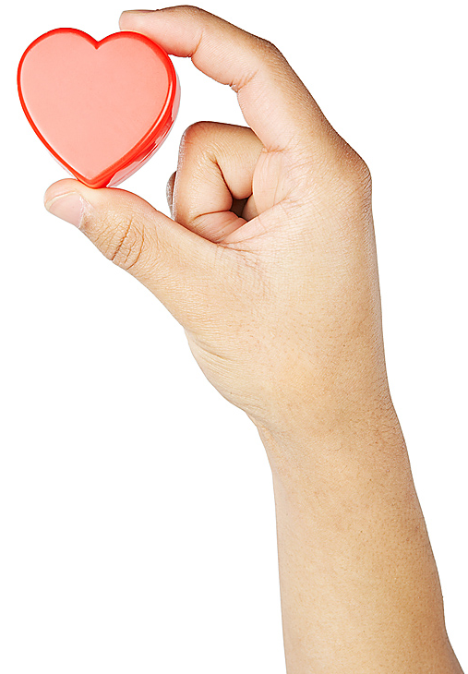
How does
happiness work?
Notes:
50% set point. Goes up/down, comes back. Mpls twins studies
10% - circumstances.
40% - intentional activity – our decisions.
40% --

Slide 9
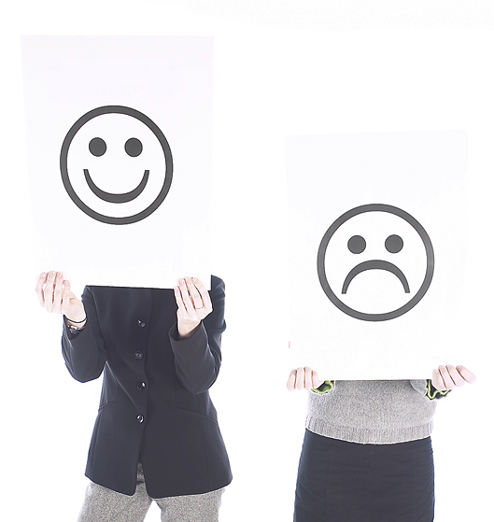

Set point
50%ß
Notes:
Set point. Not about tennis.
Up and down, come back.
Like dieting.

Slide 10
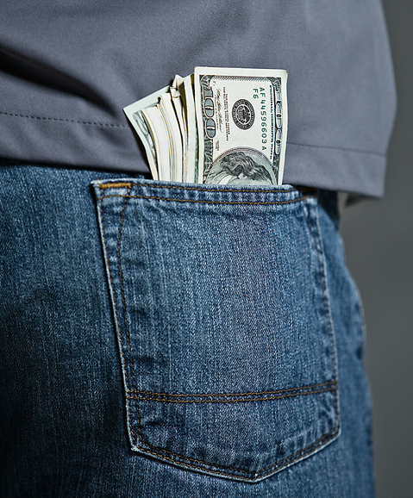
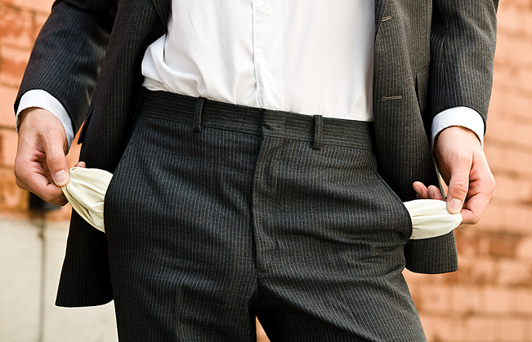
Circumstances
Notes:
Set point. Up and down, come back.

Slide 11

Circumstances
age
gender
occupation
income
home
marital status
sickenss/
health
where you live
where you grew up
personal history
family history
The slings and arrows of outrageous fortune

Slide 12
Circumstances
10%
Notes:
Set point. Up and down, come back.

Slide 13

Intentional activity
40%
Notes:
Set point. Up and down, come back.

Slide 14
Intentional activity
40% vs. 10%
What we do is 4 times more
important
than our circumstances.
(400% more!)

Slide 15
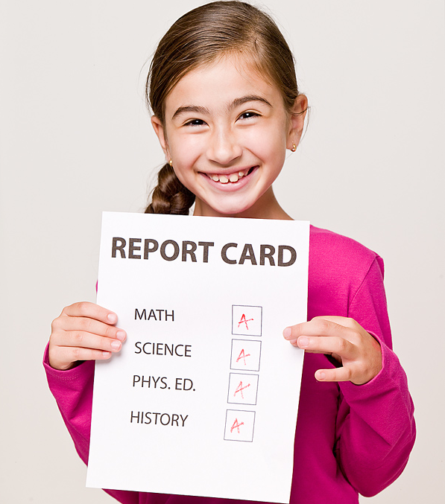
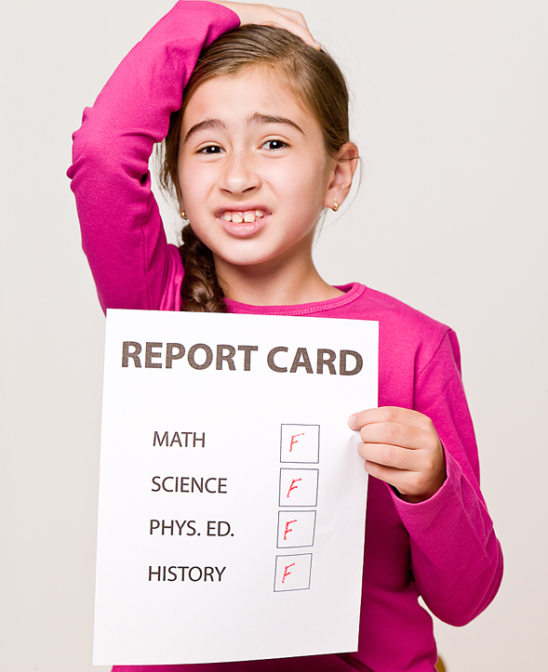
Intentional Activity = 40%
In teaching, the difference between
99%
A
59%
F
Notes:
In Teaching Terms: Difference between 100% and 60%. Or even…

Slide 16

What is Positive
Psychology?
S
Notes:
Postive psychology

Slide 17

Traditional psychology
S
Mental
illness
Notes:
Mental illness
Important : depression (ustsu byo), mental disease

Slide 18
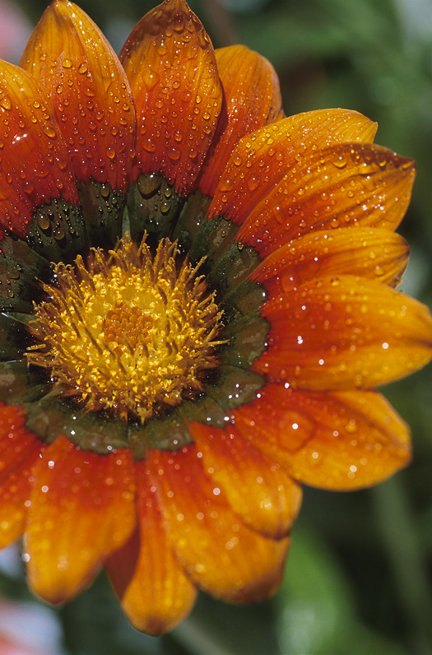
Positive psychology
S
Mental
illness
Mental
health
Notes:
Postive psychology

Slide 19
Why part of ELT?
Doesn’t have to be.
Not like vocabulary / grammar/ functions/
reading/ speaking/ etc.

Slide 20
Why part of ELT?
Any teaching
includes
educational
psychology

Slide 21
Happy students
Learn more
Work longer
More enthusiasm
http://www.centreforconfidence.co.uk/pp/overview.php?p=c2lkPTImdGlkPTAmaWQ9NA==
http://www.theage.com.au/ Don’t worry, be happy. May 8, 2006
Notes:
Learn more
Work longer at problem solving
Approach tasks with more enthusiasm.
http://www.centreforconfidence.co.uk/pp/overview.php?p=c2lkPTImdGlkPTAmaWQ9NA==
http://www.theage.com.au/ Don’t worry, be happy. May 8, 2006

Slide 22
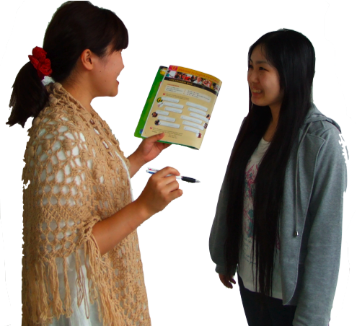
Why part of ELT?
Engaging, personalized,
multi-sensory
activities
Notes:
Engaging activities. Engagement can lead to flow. Involvement, investment.

Slide 23
Engaging, personalized, multi-sensory activities
Storm & Tecott 2005) in Willis in Sousa, 2010
Notes:
Engaging activities. Engagement can lead to flow. Involvement, investment.
Storm & Tecott 2005) in Willis in Sousa, 2010

Slide 24
Engaging activities
Focus,
memory,
motivation
Storm & Tecott 2005) in Willis in Sousa, 2010
Notes:
Dopamine ---
Engaging activities. Engagement can lead to flow. Involvement, investment.
Storm & Tecott 2005) in Willis in Sousa, 2010

Slide 25

Why part of ELT?
The “education
pressure cooker”
Notes:
For many students: educational pressure-cooker. Positive self-esteem/ positive self-regard often missing.

Slide 26

Why part of ELT?
We don’t just teach English.
We teach people.
Humanistic Language Teaching

Slide 27


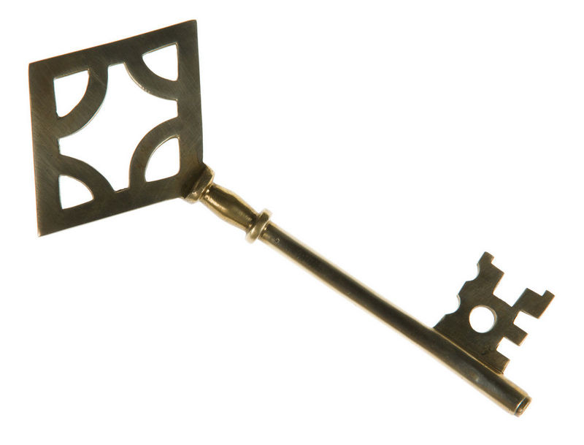
Why part of ELT?
Not magic answer
& the keys
to English
Notes:
Not Harry Potter and the Keys to English

Slide 28
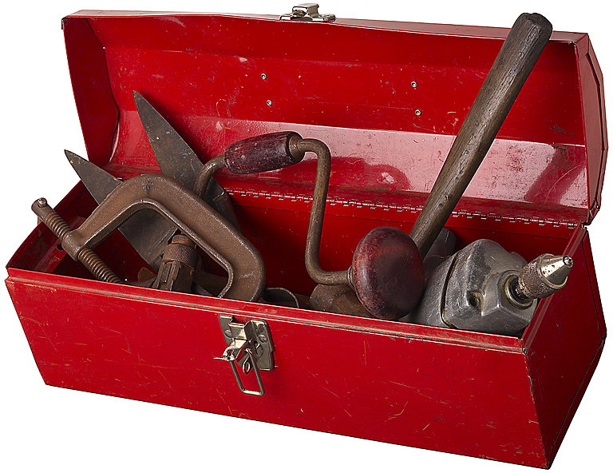
Why part of ELT?
Set of tools
The more tools we have,
the better our work.

Slide 29
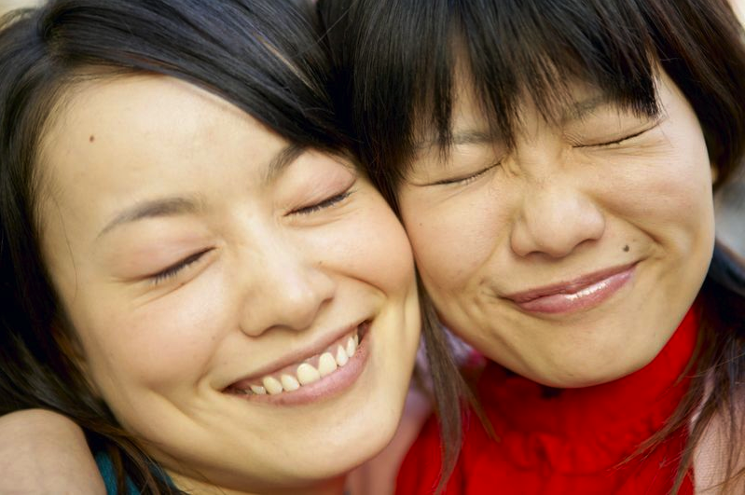
Positive psychology
is about finding out what happy, mentally healthy people do.
Notes:
Behaviorally, cognatively

Slide 30
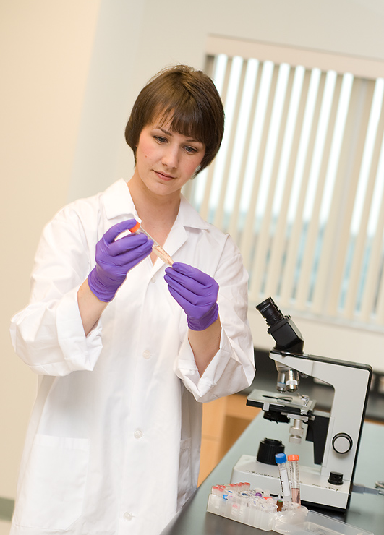
How to we get the information to our students?
Scientists know.
l
☺

Slide 31
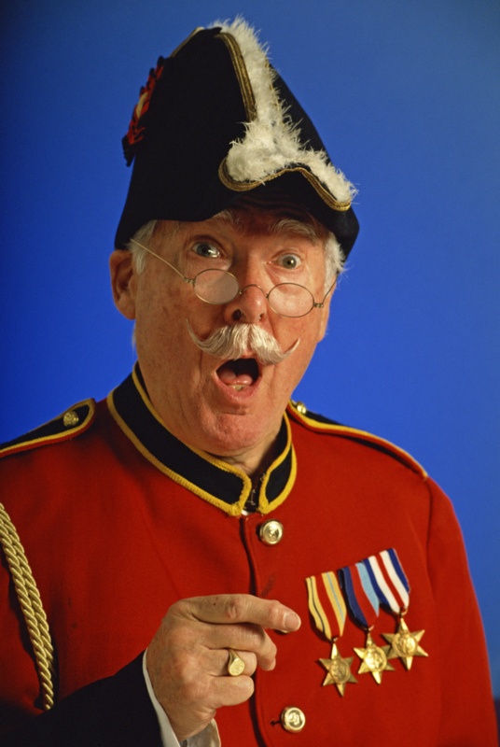
Dictation
If you use
dictation,
does that make
you a dictator?

Slide 32
Dictation
What number?
What’s your sentence?
Write it.
Notes:
Remember good things in your life

Slide 33
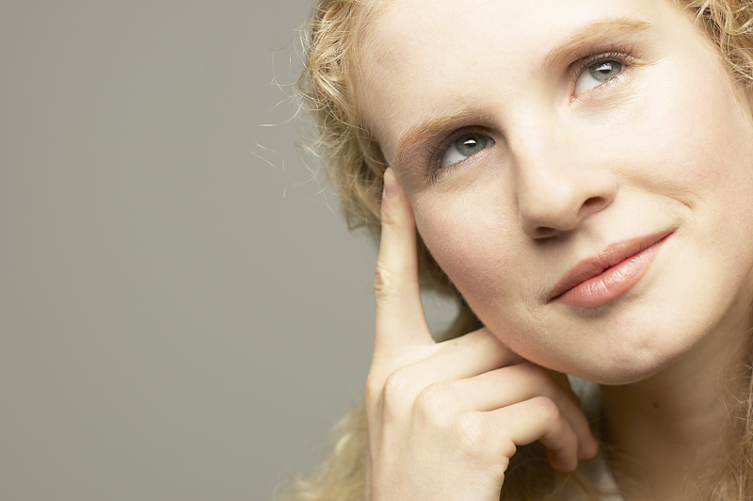
Remember
good things
Notes:
Count your blessings

Slide 34

Say,
“thank you.”

Slide 35
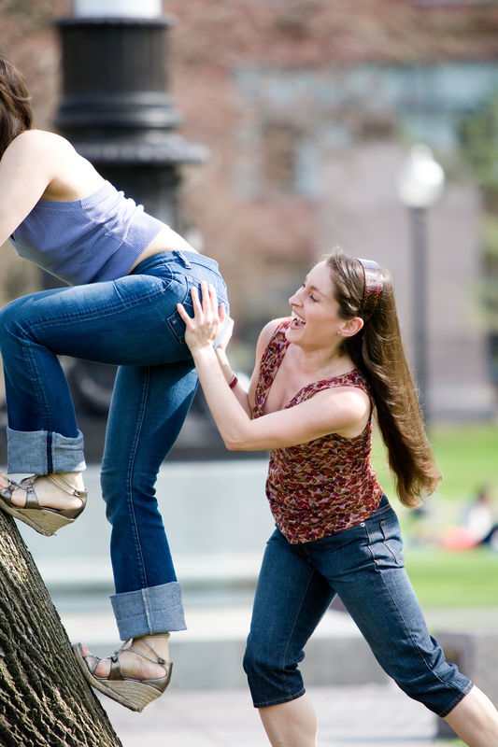
Do kind
things

Slide 36
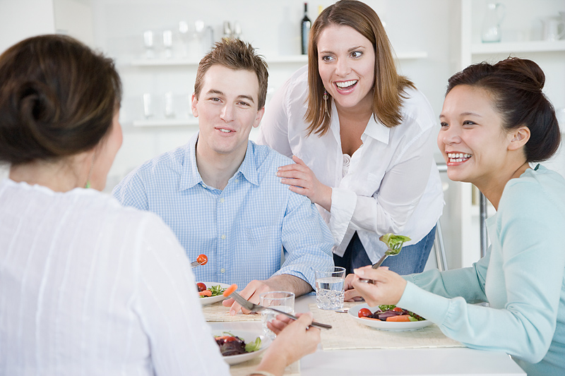
Friends
& family
Notes:
Take time for family and friends.

Slide 37
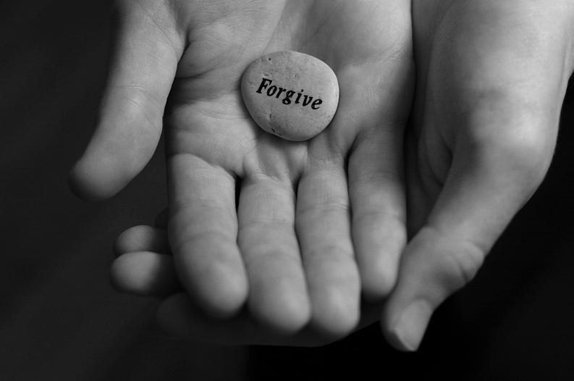
Forgive
Forgive
Notes:
Forgive others. Forgive yourself.

Slide 38
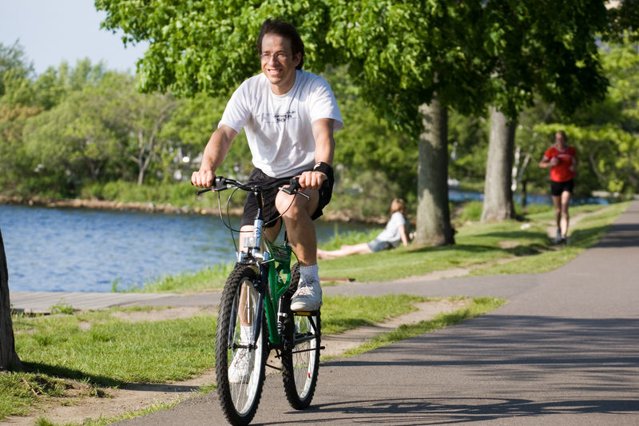
Stay
healthy
Notes:
Stay healthy. Take care of your health and body.

Slide 39
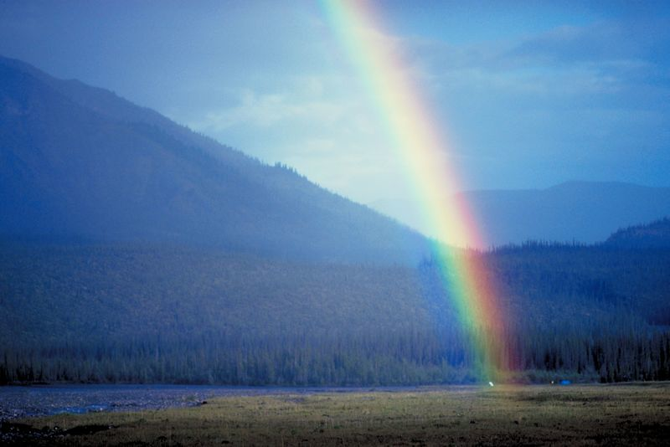
Notice good things
Notes:
This is different than remember. This is real time. English teacher: Remembering is past tense. This is present, present simple, present continuous. RIGHT Now

Slide 40
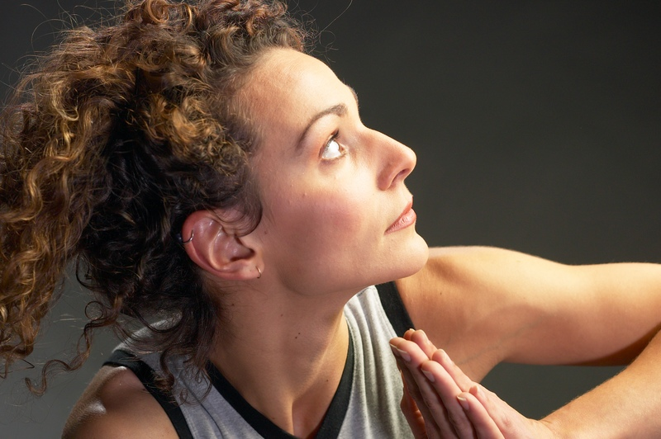
Deal
with problems
Notes:
Happy people, when they run into negative experiences, know they will pass.

Slide 41
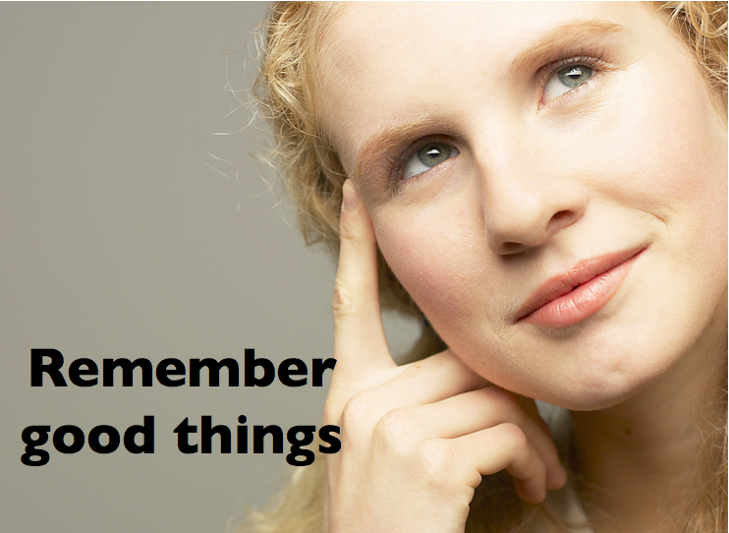
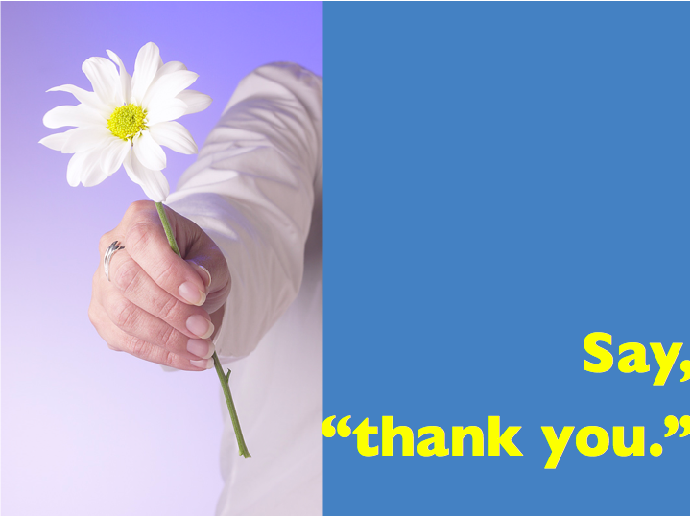
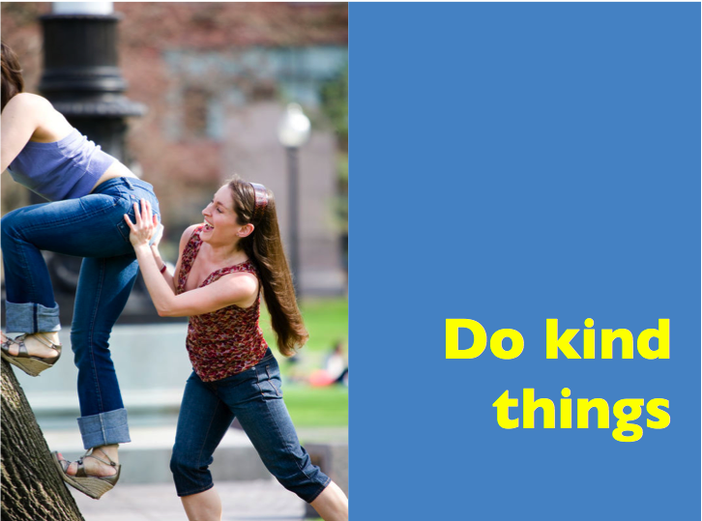
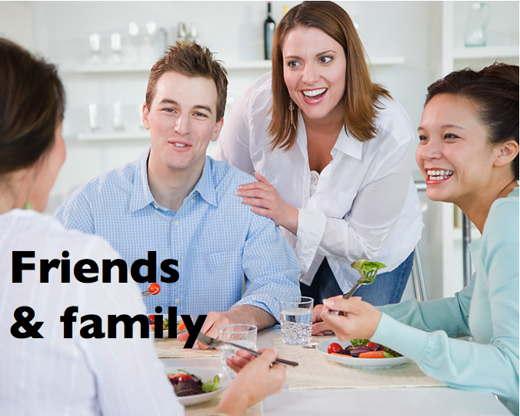
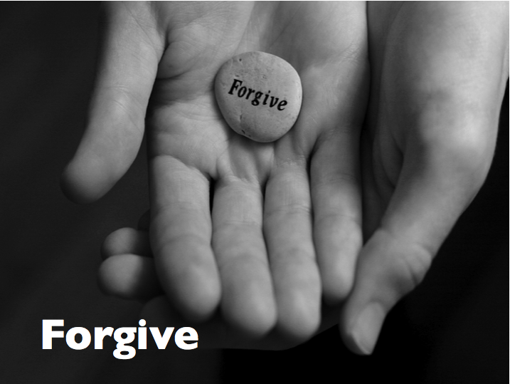
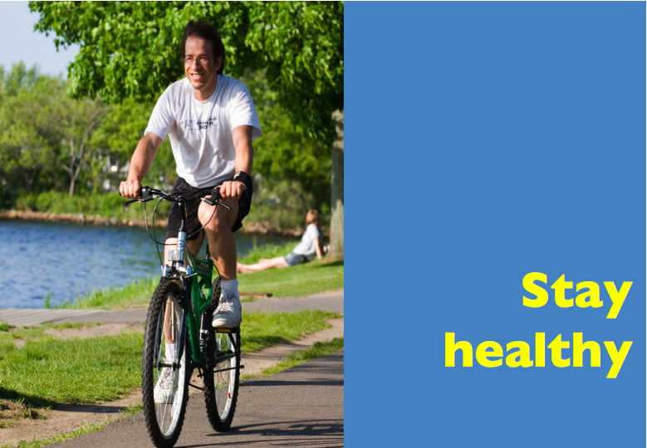
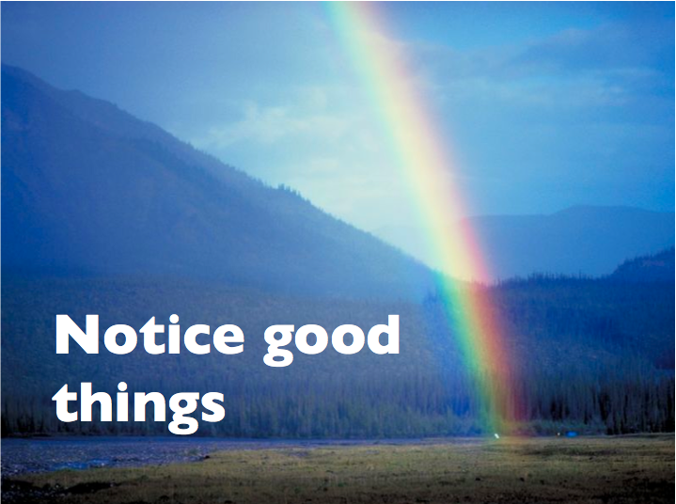
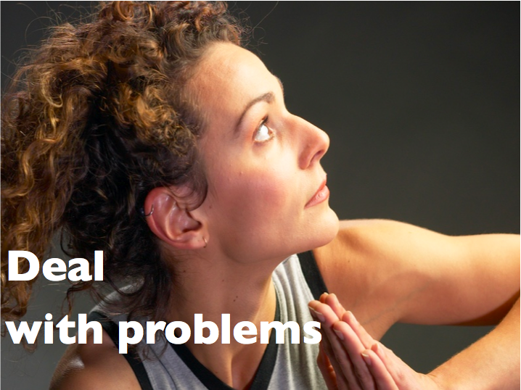
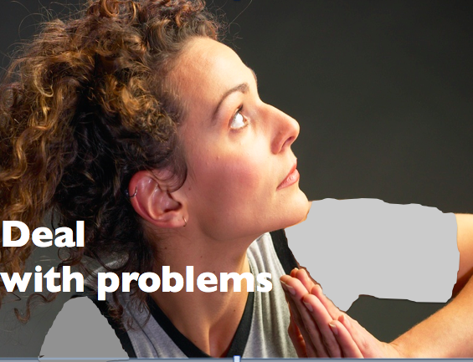
Topics
To be
happy
Grammar
Functions
Sonja Lyubomirsky, UC Riverside

Slide 42
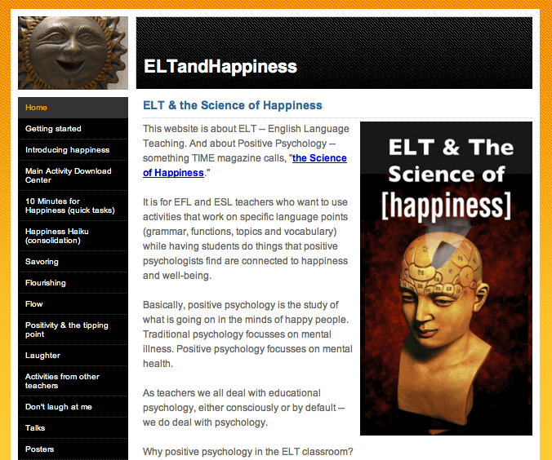
.com
Notes:
Next, how to introduce those
8 ideas into the elt classroom
You don’t have to remember. Download

Slide 43
.com
Notes:
Next, how to introduce those
8 ideas into the elt classroom
You don’t have to remember. Download

Slide 45
Remember
good things
Notes:
Count your blessings

Slide 46
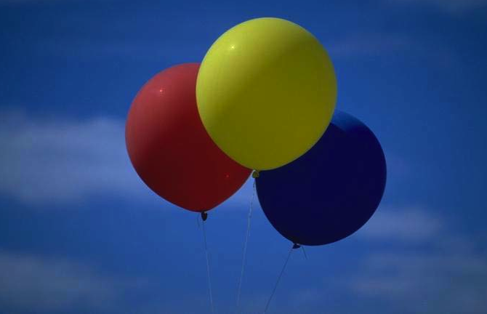
☺
3 good things, today!

Slide 47
Good thing À
Dinner tasted great tonight.
Why?
My mom’s a good cook.
OR I was really hungry.
OR Satay is my favorite.
OR I helped make dinner.
Notes:
Tasted: remembering
Mom – thank you
Pizze fav – present
I helped – doing kind things

Slide 48
Why?
☺
3 good things, today!

Slide 49
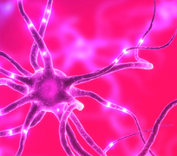
Brain BYTE

Slide 50
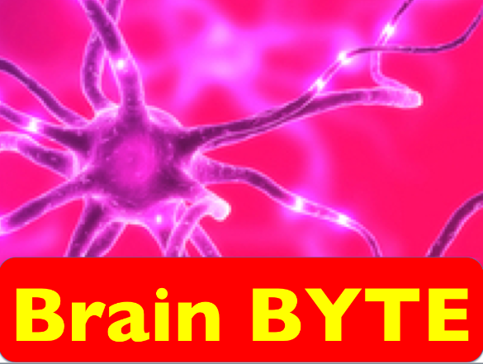
What’s the science?

Slide 51
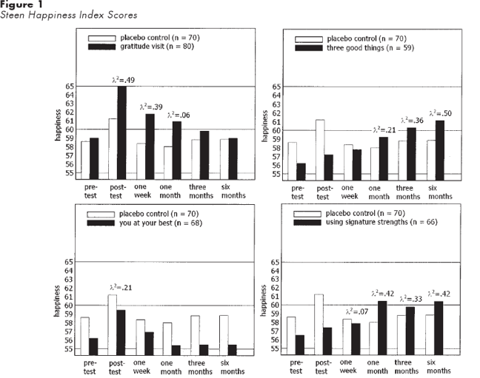

Slide 52
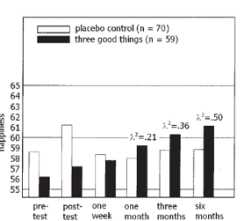
Happiness level

Slide 53
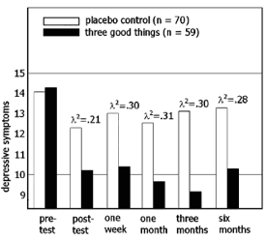
Depressive
symptoms

Slide 54
7 days
☺
6
months
of results
3 good things, today!
Notes:
Happier,
Less depression
People tend to keep doing the noticing

Slide 55




’
Active Constructive
Responses
Notes:
“Active – Constructive” responses – They help the partner mentally recreate the emotion
-- good psychologically
-- good conversation strategy

Slide 56
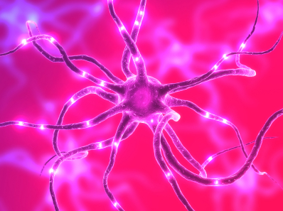
Remember good things in your life: the science:
Happy people and unhappy people actually have about the same number of positive and negative experiences.
Positive people notice the good ones.
Negative folks notice the bad ones.
Parducci 1995 in Nevin

Slide 57
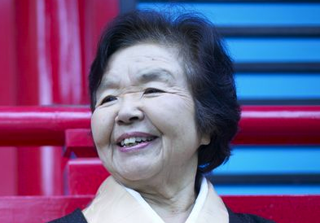
When your mom said,
“Count your blessings”
she was right.

Slide 58
Do kind
things

Slide 59
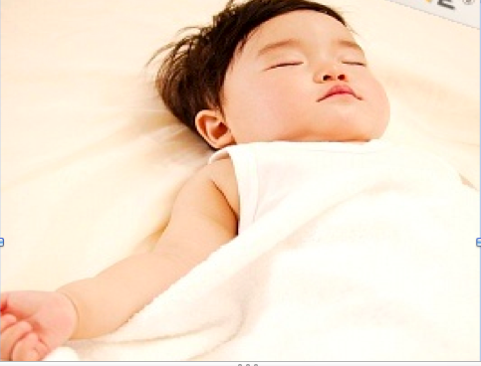
A Chinese proverb:
If you want to be happy
for an
hour,
take a
nap.

Slide 60

A Chinese proverb:
If you want to be happy
for a
day,
go
fishing.

Slide 61
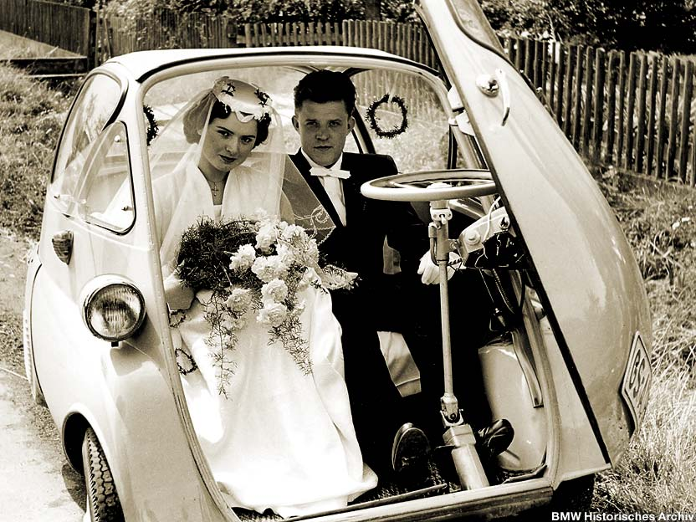
A Chinese proverb:
If you want to be happy
for a
month,
get
married.

Slide 62
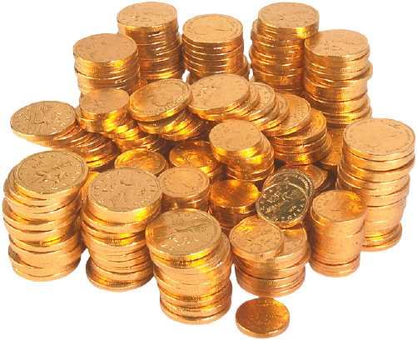
A Chinese proverb:
If you want to be happy
for a
year,
inherit
money.

Slide 63
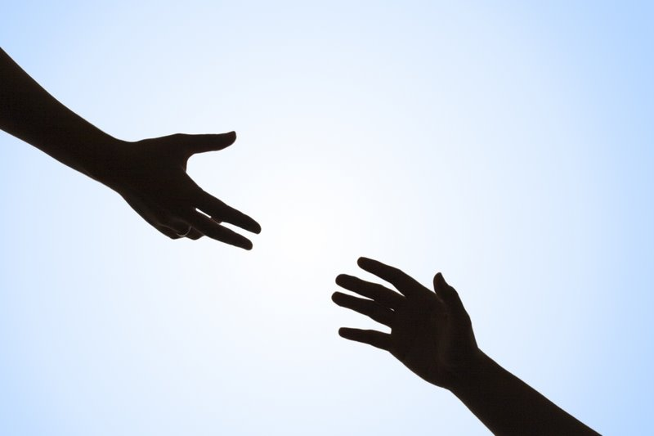
A Chinese proverb:
If you want to be happy
for a lifetime,
help
someone else.
Notes:
Happiness comes from withing?
Happiness comes from BTWEEN – Johnathan Haidt

Slide 64
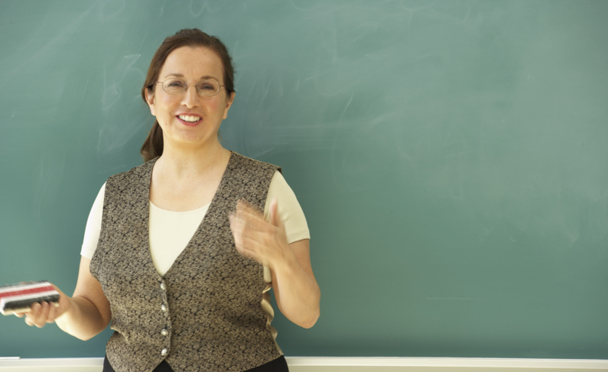
Compliments
We made the teacher laugh.
s v o c
Notes:
The complement

Slide 65
Compliments
You’ve got a beautiful smile.
That’s a really nice scarf.
You’re really nice.
Cool jacket!
You’re always on time.
You’re so smart.
You are really creative.
Notes:
CULTURAL

Slide 66
Compliments
 Work in groups of 4-5.
Think of one true compliment for each person.
• Compliment each partner.
Partner, just say, “Thank you.
Notes:
CULTURE
Japan – deny it
Thailand/ Pakistan: “Oh, I’ll give it to you”
Samoa/ pacific islands – really will give it to you
Many English speaking cultures- just say thank you.
Not suggesting, I (as NEST) do therefore Ss should, am suggesting they should be award of different options.

Slide 67
Compliments
You’ve got a beautiful smile.
That’s a really nice scarf.
You’re really nice.
Cool jacket!
You’re always on time.
You’re so smart.
You are really creative.
Notes:
Cultural activity

Slide 68

Compliments
 When you finish, remember each compliment.
She said I have a nice smile.
He said I am creative.
Every time you remember a
compliment, smile.
Notes:
HOW MANY TIMES EACH?
Think
Say
Hard
Reprocess: It is a drills

Slide 69
Do kind things - the science:
Life satisfactions (being happy with life) is about 24% higher in people who do kind things. Williams, Haber, Weaver & Freeman, 1998
People who volunteer are, on average, twice as likely to feel happy as non-volunteers. Crist-Houran, 1996 ((Niven)
Notes:
Niven – 100 simple secrets of happy people. 2006. Harper Collins

Slide 70
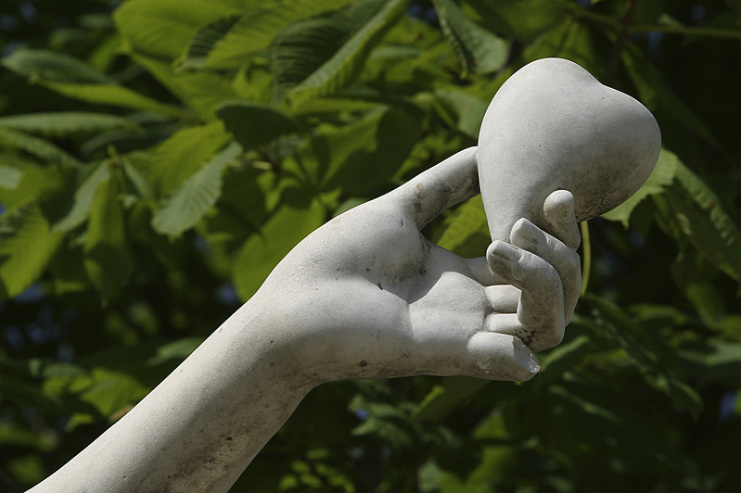
Kindness gives
birth to
kindness.
-Greek proverb

Slide 71
Say,
“thank you.”

Slide 72

Thank you to the world
 How many languages
can you say “thank you” in?
• Why do you want to say
thank you to each country/language?
Notes:
Shu-kri-yaa

Slide 73

Thank you to the world
• Why do you want to say
thank you to each country/language?
  I want to say “grazie” to Italy.
  They gave the world some
  great art.
  And pizza.
Notes:
Shu-kri-yaa

Slide 74


Thank you to the world
  I want to say
  “ ”
  to Indonesia
  for…
Terima kasih
Indonesian
teachers!
Notes:
Mangos, papayas, pineapples, bananas – wonderful FRESH FRUIT

Slide 75

Thank you to the world
  I want to say
  “ ”
  to China for…
谢谢
Notes:
She-she (xi-xi

Slide 76
Thank you to the world
  I want to say
  “ ”
  to _____ for…
__________
Notes:
She-she (xi-xi

Slide 77
Friends
& family
Notes:
Take time for family and friends.
Culture: Some east Asians (inc. Japanese) social relationships more important that European North Americans. (Group culture) Within European, range- Italians more social than Scots.

Slide 78



Someone special
Think of someone special in your life.
A family member
Someone who
helped you
A special teacher

Slide 79

Mom or dad
A special teacher
A coach
A special friend
Who would you write to? Why?

Slide 80


Gratitude letter
I want to thank you…
Notes:
Standard activity. I learned about it from something Martin Seligman wrote (U. Pennsylvania). Christopher Peterson (U. of Michigan) worked with Seligman, now u. of Michigan. Nansook Park (student – now Director of UMich PosPsych centerwe do that every year.

Slide 81
Mom or dad
A special teacher
A coach
A special friend
Who would you write to? Why?

Slide 83


Slide 85
Thanking people the science
People who show gratitude (say “thanks”)
• deal with stress better.
• have more positive interactions with others.
• have more energy
• have fewer physical problems
• healthier hearts Midcolumbia Medical Center

Slide 86
Time for friends & family the science
“Share yourself.” People who are “socially open” (active with friends) rate themselves 24% happier than people who are not.
Finch, Barrera, Okun, Bryant, Pool, and Snow-Turek 1997 Niven

Slide 87
Forgive
Forgive
Notes:
Forgive others. Forgive yourself.

Slide 88

Not to forgive is like
drinking poison
and then hoping it will
kill your enemies.
- Nelson Mandela
Notes:
27 years in prison
Every right, every reason to hate the people. But he said: (CLICK)

Slide 89


Forgive
✰ Think of people who have hurt you. Who DIDN’T you forgive yet?
• Put one arm
straight out.
Hold something heavy.
Notes:
Note to teacher.
Make sure they know they won’t be asked to talk about the bad thing (it may be private).
Also give them time to think of something specific.

Slide 90
 Read this silently.
Your teacher will read it aloud:
Someone did something bad to you.
Forgiveness does NOT mean it was OK.
Forgiveness does NOT mean that person can do it again.
Forgiveness is important for things that must NOT be done again.
Notes:
Note to teacher. Read this is a slow, calm voice. Give them time to think about each line.

Slide 91
When you do not forgive, who is hurt?
The person who did the bad thing usually doesn’t know.
  Or doesn’t remember.
  Or doesn’t care.

Slide 92
The anger is in your heart.
You carry the weight.
It does not help to know why the person did the bad things.
      - Usually that person
  doesn’t know.

Slide 93

Heavy, isn’t it?
You carry the weight.
You have the power to
let it go.

Slide 94
Forgive
You have the power to
let the hurt go.
Metaphor can teach
things we can’t
teach directly.

Slide 95
Forgiveness – the science
Studies of university students thinking
about “hurtful memories” found those
who forgive others have:
- less stress
- healthier body functions (heart rate,
blood pressure, EMG (electromyogram -- tests nerve/muscle function)

Slide 96
Forgiveness – the science
Forgiving others also seems connected to less:
• anger
• depression
• negative thoughts
• alcohol/drug abuse
https://www.amsa.org/healingthehealer/forgiveness.cfm
American Medical Association Student Association

Slide 97


Slide 98
Stay
healthy
Notes:
Take care of your health and body.

Slide 99

Eat right.
Exercise
regularly.
Die anyway.
- Author unknown & probably dead.

Slide 100

Most of us know
what to do to
be healthy.
We need to
actually do it!
Notes:
KFC drops transfat.
Class action suit -- you didn’t tell us.
Judge through it out saying, essentially
“You thought fried chicken was health food.”
- parents smoking “you’re going to get sick” innervoice story.

Slide 101
Take care of your health- the science
Regular exercise like walking =
increases happiness 12%.
It also leads to better self image.
People who eat a lot of fruit have 11% more feeling of being able to do things and being satisfied. Healtey and Thombs 1997 (Niven)

Slide 102

Take care of your health - the science
Smoking takes 3-6 years off your life.
Unhappiness
takes off
about
9 years.
Smoking: BBC 2006,
Milwaukee Nun Studies -Seligman, 2002,
Emmons (2007) Thanks!

Slide 103

Smiling –
some science
• makes us attractive
• changes our mood
• is contagious
• reduces stress
• boosts immune system
• lowers blood pressure

Slide 104
Smiling –
some science
• releases endorphins & serotonin
• makes you look
younger
• makes you seem successful
• helps you stay positive

Slide 105

by which I mean “a little weird”.
Smile writing
This activity is experimental
is
(name)
great!
wonderful!
brilliant!
a super student.
fantastic.
Pencil image © polis poliviou Creative Commons
Notes:
Release enDORPHins

Slide 106

Notes:
Endorphins into the brain

Slide 107


Laughter and smiles - the science
• We reflect faces, smiles or frowns.
Lundqvist and Dimberg 2005 p. 135
• One minute of heavy laughter
= same health benefits of 1 hour workout
Gunther Sicki, 2004

Slide 108

Laughter and smiles - the science
In a study of heart attack victims,
43% of the control group had another
heart attack within one year.
Only 8.3% of experimental group did.
Lee Berk, 1996
The Intervention: 30 min. of humor video/day.

Slide 109
Notice good things
Notes:
This is different than remember. This is real time. English teacher: Remembering is past tense. This is present, present simple, present continuous. RIGHT Now

Slide 110
Notice good things when they happen.
Note - different than “Remember good things in your life.”
That’s remembering (past tense).
This is noticing as it happens.
                (mindfulness/present)

Slide 111

The past
is history.
Grand Master Oogway
Kung Fu Panda

Slide 112

The future
is a mystery.

Slide 113

That is why it
is called
“the
present.”
Today is a gift.
Notes:
Thanks to Michael Krigline, a teacher in China for calling this to my attention.

Slide 114
The basketball game
Watch the video.
How many passes does
the team in WHITE make?

Slide 115

Notes:
Mouse only, not remocon

Slide 116

Notes:
Lung scan 83% radiologists miss it

Slide 118

Take the time to
smell the roses

Slide 119

Eat a blueberry with mindfulness
Notes:
But there is a mindfullness meditation I do with my students. And ’ld like to do it with you.

Slide 120
Notice good things when they happen.
 Work with a partner.
You will have one minute.
• How many good things can you say about today/ right now?

Slide 121

Notice good things when they happen - the science
The actual number of good and bad
events have little to do with happiness. What counts is the beliefs about what has been experience. Chen 1996 (in Niven)
People who like what they have are twice as likely to be happy with what they have. (compared with folks who have more). Cole, Kosenko, and Meadow, 1995 (Niven)

Slide 122

simplify

Slide 123
Deal
with problems
Notes:
Happy people, when they run into negative experiences, know they will pass.

Slide 124

Find ways to deal with
problems
stress
sadness
Bad things happen
to everyone

Slide 125

Moving on
Everyone has problems.
Happy people know
they will pass.
 Think of a problem you had in the past.
• How did you get past it?
 Tell a partner.
Notes:
Notice. Not bad story- success

Slide 126
Find ways to deal with problems/ stress / sadness

Slide 127

Find ways to deal with problems/ stress / sadness
Bad things happen
to everyone
Notes:
Tal ben Shahar – Harvard:
Only two groups don’t experience painful emotions: psychopaths, the dead.

Slide 128

Find ways to deal with problems/ stress / sadness
Faith & spirituality

Slide 129

Find ways to deal with problems/ stress / sadness
Social connections (friends)

Slide 130
Find ways to deal with problems/ stress / sadness
Proverbs, beliefs & aphorisms
- Useful ways to look at things
- Positive self-talk
- Create self-fulfilling prophesies
        - Lyubomirsky 2007

Slide 131

No rain,
no rainbows.
- Hawaiian Proverb

Slide 132

You can’t stop the waves.
But you can learn to surf.
- Jon Kabat Zinn

Slide 133



When life gives you lemons…
…make lemon butter sautéed
chicken breasts
with herbs & baby asparagus

Slide 134

What we think, we become.
-The Buddha

Slide 135
Dealing with stress - the science
• People of faith are 3 times more likely to be alive 6 months after heart surgery than those without faith.
Lyubomirksky 2007 p. 228
• Meditation/relaxation training is associated with reduced pain & depression, and increase in awareness, calmness and control.
McKay in Lopzez (ed.) , 2013, p. 901

Slide 136

Memory test
There were 8
“happiness” ideas.
Work with a partner.
How many can
you remember?

Slide 137
To be
happy
Sonja Lyubomirsky, UC Riverside

