Slide 1
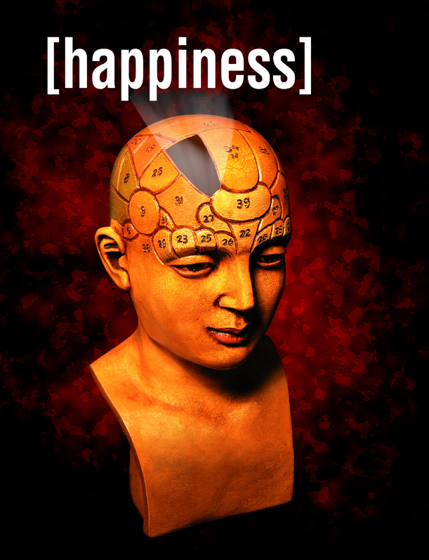
S
ELT & the science of
Compliments
Notes:
Excited, delighted.
Who are you?
1st part: What is Positive psychology
2nd part: How connect that to ELT – also language and cross cultural connections.
Then a break and “Happiness 2.0”
You may think: Wait. Have to teach speaking, listening, reading, and writing? Now I’m responsible for happiness.
Not really. It can be a tool. But any teaching… (next slide)

Slide 2
Complements
We made the teacher laugh.
s v o c
Notes:
CULTURAL

Slide 3
Compliments
You’ve got a beautiful smile.
That’s a really nice scarf.
You’re really nice.
Cool jacket!
You’re always on time.
You’re so smart.
You are really creative.
Notes:
CULTURAL

Slide 4
Compliments
 Work in groups of 4-5.
Think of one true compliment for each person.
• Compliment each partner.
Partner, just say, “Thank you.
Notes:
CULTURE
Japan – deny it
Thailand/ Pakistan: “Oh, I’ll give it to you”
Samoa/ pacific islands – really will give it to you
Many English speaking cultures- just say thank you.
Not suggesting, I (as NEST) do therefore Ss should, am suggesting they should be award of different options.

Slide 5
Compliments
You’ve got a beautiful smile.
That’s a really nice scarf.
You’re really nice.
Cool jacket!
You’re always on time.
You’re so smart.
You are really creative.
Notes:
Cultural activity

Slide 6
Compliments
 When you finish, remember each compliment.
She said I have a nice smile.
He said I am creative.
Every time you remember a
compliment, smile.
Notes:
HOW MANY TIMES EACH?
Think
Say
Hard
Reprocess: It is a drills

Slide 7
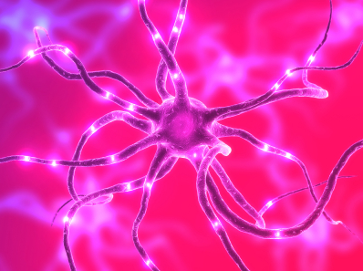
Do kind things - the science:
Life satisfactions (being happy with life) is about 24% higher in people who do kind things. Williams, Haber, Weaver & Freeman, 1998
People who volunteer are, on average, twice as likely to feel happy as non-volunteers. Crist-Houran, 1996 (Niven)

Slide 8
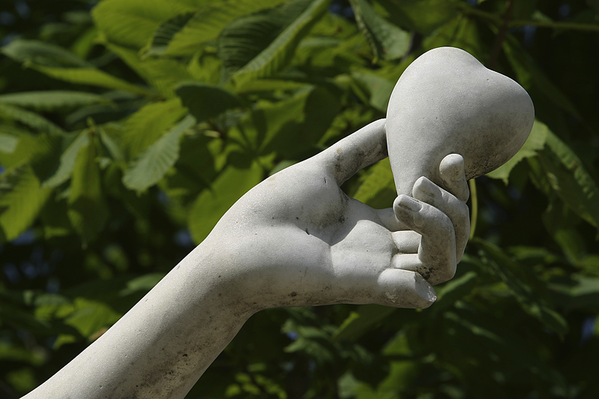
Kindness gives
birth to
kindness.
-Greek proverb

