Slide 1
Notes:
What is happiness?
Aristotle said that happiness is “the meaning and the purpose of life, the whole aim and end of human existence.
But positive psychology says that we don’t need to pursue it: we create it from what we have already
Most importantly small changes to our lives can increase our happiness dramatically

Slide 2
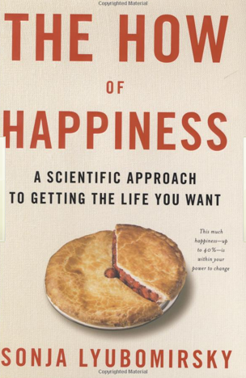
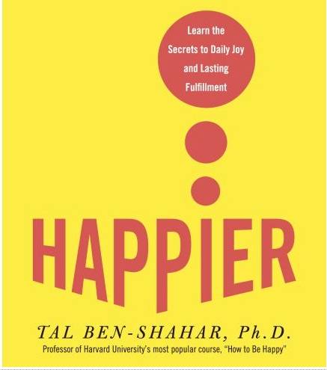
Scientifically proven!
Notes:
Psychology generally focused on unwell people
People with terrible disorders and diseases
Positive psychology focuses on the habits of happy people
It is no longer a minor field in psychology
These books were written by professors from:
Uni of California,
Uni of Pennsylvania
Harvard ( their most popular class: How to be happy)

Slide 3
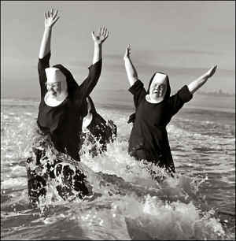
Notes:
All the research points us in the same direction:
people can have very similar lives but how they see those lives makes all the difference
Famous study where the subjects all lived very similar lives:
Milwaukee nuns; researchers looked at their entry letters when they became nuns and how long the nuns lived for
Smoking a lot takes about 6 years off your life
Depression may take 9 years off your life

Slide 4
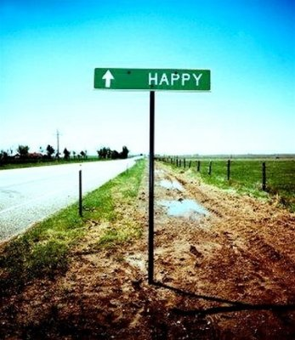
Notes:
Sonja Lyubormisrsy’s research has shown that we all have a genetically determined set point for happiness
But this only accounts for 50% of our happiness
Another 10% has been shown to be accounted for by things external to use: your wealth, your health, how the weather is today
But 40% of your happiness is up to how you live your life
The small choices you make
And she distills these into various habits that you can easily incorprorate into your life
We’re talking about small things: 8 habits of happy people

Slide 5
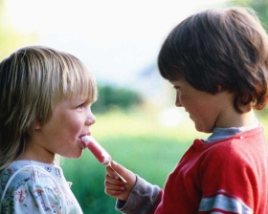
Notes:
Do kind things: doesn’t mean buying huge presents. It doesn’t cost anything: hold a door open for someone. Help your friend carry things. Help a stranger

Slide 6
Notes:
People who are happy make other people happy by saying thank you
Or thank a family member: they won’t be there forever.

Slide 7
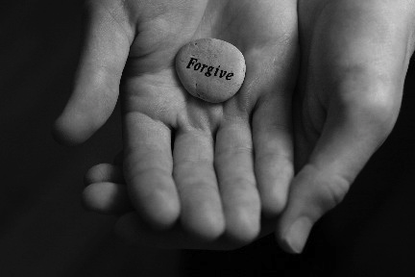
Notes:
One of the habits of happy people is to Forgive people who do you wrong
Forgiveness in positive psych does NOT mean a reconciliation with the person who hurt you
Forgiveness is something that you do in yourself
You may never tell the person that you have forgiven them
They don’t care
The only one who is hurting is you; it doesn’t mean that what the other person did was right but let it go
That’s easy enough when the thing to be forgiven is a trifle
It’s much harder when the wrong that has been done to you or someone you cared about is too great to forgive

Slide 8
Notes:
Some wrongs may be inexcusable but try not to dwell on them

Slide 9
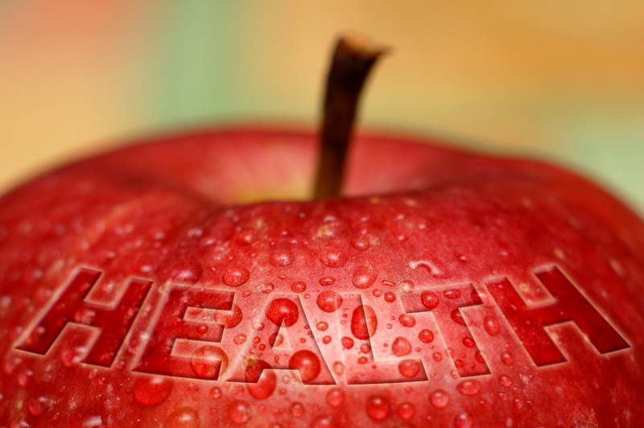
Notes:
Food and exercise
Take care of your physical health

Slide 10
Insert your own pic of your family here
Notes:
Insert your own pic of your family here
Make time for your family and your friends
It takes seconds to send a text or pick up the phone and a few minutes to send a postcard
Everybody is busy
When you die, do you think you’ll be saying Oh I wish I had spent more time in the office?

Slide 11
Notes:
Enjoy little things
You don’t need loads of money to enjoy simple pleasures in life
A coffee with friends
A good book
A bar of Lotte rum raisin chocolate, in my case

Slide 12
Insert your picture of a happy memory .
( I used a Christmas party with my students.)
Notes:
Insert your picture of a happy memory . ( I used a Christmas party with my students.)
Remember the good times!
Think about the nice things that you have done: look at old pictures with friends
A happiness diary can be a good idea but only do it once a week; don’t make it chore
Re-read your old dairies and smile: keep the silly letters from your friends

Slide 13
Notes:
Positive psych is not for touchy-feely tree-hugging people
It recognises that everyone has stress
But we can learn to manage it
Find things to help you relax
Don’t be afraid to ask for help from family, colleagues
Also from health professionals, if you think start to feel that everything is too much trouble, you might want to consider professional help

Slide 14
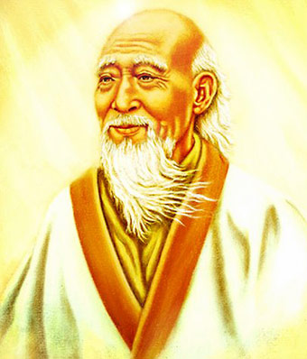
Notes:
Finally I’d like to introduce an Ancient Chinese proverb about being happy
I borrowed this proverb from Marc’s Happiness workshop a few years ago
If you want to be happy for 1 hour what would you do?
Ask your audience and give your own suggestions.

Slide 15
Notes:
Take a nap
If you want to be happy for one afternoon?
Ask your audience and give your own suggestions.

Slide 16
Notes:
Go fishing
If you want to be happy for one month?
Ask your audience and give your own suggestions.

Slide 17
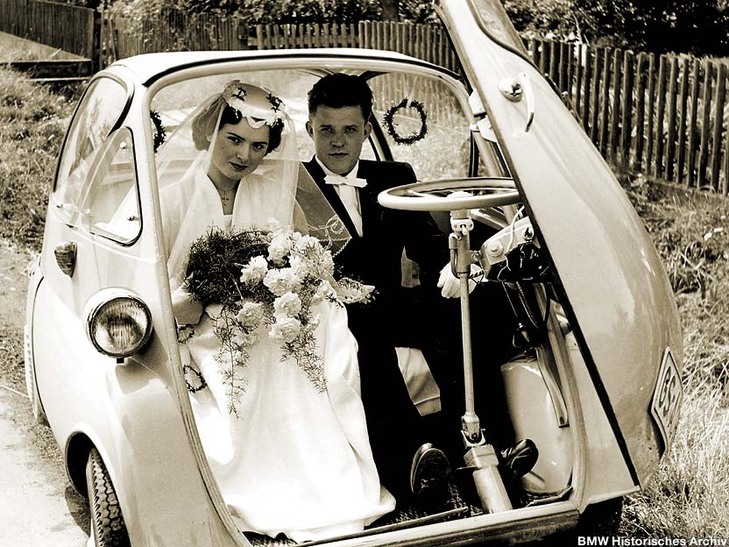
Notes:
Get married
If you want to be happy for one year?
Ask your audience and give your own suggestions.

Slide 18
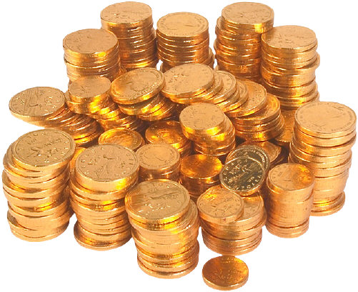
Notes:
Inherit a fortune
If you want to be happy for your whole life?
Ask your audience and give your own suggestions.

Slide 19
Notes:
Help someone else
Do voluntary work; give your time to a cause that you believe in
Happiness is an attitude
No one else can make you happy

Slide 20
You decide your happiness
You decide your happiness
Notes:
OK you have a genetically set point for 50% of your happiness
But 40% of your happiness is up to how you live
You can start by practising these 8 habits of happy people
You decide your happiness
(I put this PechaKucha together when I asked my own students to create PKs and decided I better find out how challenging it was. We then had a PK party as our final class, and I presented this at the end for students. This PK was inspired by Marc Helgesen’s Happiness workshop at JALT several years ago, and I drew upon the three books in the second slide to create it. The pictures were taken from various Internet sites and I do not own copyright of any of them. Questions? el-kane@u-shimane.ac.jp)

