Slide 1
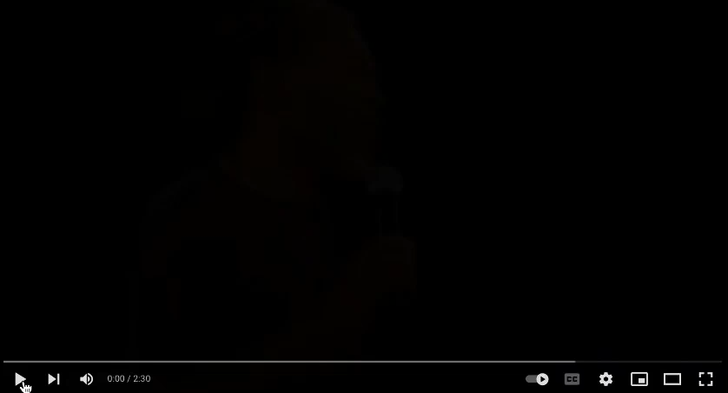
I can see clearly now
the rain is gone
I can see all popsicles
in
my way
Gone are the dark clouds
that had me blind
It's gonna be a bright
(Bright) Bright (Bright)
sunshiny day.
s
I can see clearly now
the rain is gone
I can see all obstacles
in my way
Gone are the dark
clouds
that had me blind
It's gonna be a bright
(Bright) Bright (Bright) sunshiny day
I think can make it
Now, the rain is gone
All of the bad feelings
have disappeared
Here is that rainbow
I've been praying for
It's gonna be a bright
(Bright) Bright (Bright)
sunshiny day
Look all around, there’s
nothing but blue skies.
Look straight ahead, ,
there’s nothing
but blue skies.

