Slide 1
NOTE TO TEACHERS
There are 2 versions of the PowerPoint.
Slides 2 – 18 use only “You’re beautiful, (name).”
It is designed for the 1st day of class, before students know more about each other. I’m trying to use “beautiful” with a wider meaning than “physically attractive.”
Slides 20 –36 have student complementing each other on many topics.
This works better if your students have name tags.
Hope your students enjoy this.

Slide 2
Your smile
is beautiful

Slide 3
Let’s smile
together
& learn each
other’s names.

Slide 4
When someone says…
“You’re beautiful.”
Photos courtesy:

Slide 5
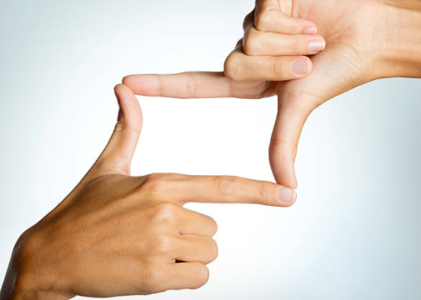
Hold your hands
like a camera lens.

Slide 6
For each person, say,
“You’re beautiful, (name).”
See what
they do.

Slide 7
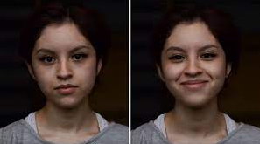
“You’re
Beautiful,
Mai.”
“Thank you.”

Slide 8
If you are wearing a mask.
“You’ve got
beautiful eyes,
Mai.”
“Thank you.”

Slide 9
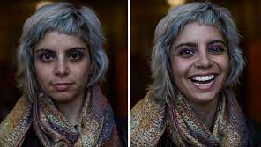
“You’re
beautiful,
Nina.”
“Thank you.”
“Thank you.”

Slide 10
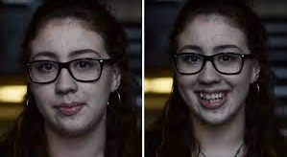
“You’re
beautiful,
Emi.”
“Thank you.”

Slide 11
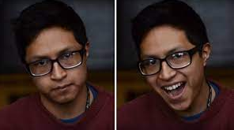
“You’re
beautiful,
Jojo.”
“Thank you.”

Slide 12
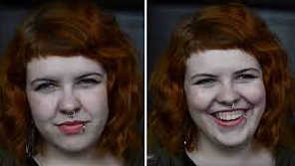
“You’re
beautiful,
Kate.”
“Thank you.”

Slide 13
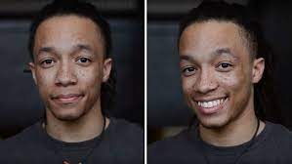
“You’re
beautiful,
Nick.”
“Thank you.”

Slide 14
Stand up.
Walk around.
Greet people.

Slide 15
“Take a picture.”
Say, “You’re beautiful, (name).”
See what
they do.
Partner, say
“Thank you,
(name).”

Slide 16
Meet many people.
Can you
remember the names?

Slide 17
Finished?
Go to
Search for
“
“People react to
being called beautiful.”
Enjoy.
https://www.youtube.com/watch?v=aW8BDgLpZkI&t=7s

Slide 18
How many names
can you remember?

Slide 19
ß
"Sometimes
your joy is the
source of
your smile.
Sometimes
your smile
can be the
source of
your joy.”
Photo:
Unsplash.com
-Thich Nhat Hahn

Slide 20
Based on a
social experiment
by “Martin Scorsexy” at
Chicago High School
for the Arts

Slide 21
https://www.boredpanda.com/people-told-you-are-beautiful-video-shea-glover/?utm_source=google&utm_medium=organic&utm_campaign=organic

Slide 22
When you say something
nice about someone.
Compliments

Slide 23
Let’s give
compliments
& learn each
other’s names.

Slide 24
When someone says…
something nice.
Photos courtesy:

Slide 25
Hold your hands
like a camera lens.

Slide 26
For each person,
Give a compliment,
Say their
(name).
See what
they do.

Slide 27
“You have a
beautiful smile,
Mai.”
“Thank you.”

Slide 28
If you are wearing a mask.
“You’ve got
beautiful eyes,
Mai.”
“Thank you.”

Slide 29
“Nice scarf,
Nina.”
“Thank you.”
“Thank you.”

Slide 30
“You always make me laugh,
Jojo.”
“Thank you.”

Slide 31
“You’ve got
beautiful hair,
Kate.”
“Thank you.”

Slide 32
“You’re
really kind,
Emi.”
“Thank you.”

Slide 33
“I like being
around you,
Nick.”
“Thank you.”

Slide 34
Stand up.
Walk around.
Greet people.

Slide 35
“Take a picture.”
Give a true compliment,
Say their (name).”
See what
they do.
Partner, say
“Thank you,
(name).”

Slide 36
Meet many people.
Can you
remember the names?

Slide 37
Finished?
Go to
Search for
“
“People react to
being called beautiful.”
Enjoy.
https://www.youtube.com/watch?v=aW8BDgLpZkI&t=7s

Slide 38
How many names
can you remember?

Slide 39
ß
"Sometimes
your joy is the
source of
your smile.
Sometimes
your smile
can be the
source of
your joy.”
Photo:
Unsplash.com
-Thich Nhat Hahn

Slide 40
Based on a
social experiment
by “Martin Scorsexy” at
Chicago High School
for the Arts

Slide 41
https://www.boredpanda.com/people-told-you-are-beautiful-video-shea-glover/?utm_source=google&utm_medium=organic&utm_campaign=organic

