Slide 1
I DON’T
suggest:
Checking your phone..
Solen Feyessa
@ Unsplash
https://www.statista.com/statistics/219865/percentage-of-us-adults-who-own-a-smartphone/

Slide 2
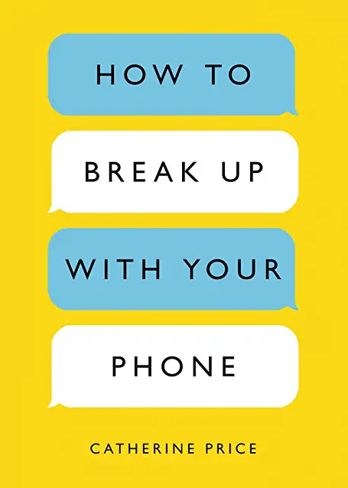
Solen Feyessa
@ Unsplash

Slide 3
I DON’T
suggest:
Checking your phone..
85% of Americans
have smartphones.
2/2021
Solen Feyessa
@ Unsplash
https://www.statista.com/statistics/219865/percentage-of-us-adults-who-own-a-smartphone/

Slide 4
I DON’T
suggest:
Checking your phone..
85% of Japanese
have smartphones.
2022
> 90% of HS Students
> 50% of JHS Students
Average age Elem: 10.6 yrs
Solen Feyessa
@ Unsplash
https://www.statista.com/statistics/275102/share-of-the-population-to-own-a-smartphone-japan/#:~:text=It%20was%20estimated%20that%20more,than%2069%20percent%20in%202018.
https://www.nippon.com/en/japan-data/h00442/smartphones-becoming-standard-for-japanese-high-schoolers.html#:~:text=Over%2090%25%20of%20high%20school,school%20students%20own%20a%20smartphone.
https://www.asahi.com/ajw/articles/14588165

Slide 5
I DON’T
suggest:
Checking your phone..
Americans adults check 47*times/day.
18-24 yrs – 82 times
* - some sources – 334 x/day
Solen Feyessa
@ Unsplash
Price, C. (2018) How to Break Up With Your Phone NY: Ten Speed Press
* https://www.reviews.org/mobile/cell-phone-addiction/

Slide 6
I DON’T
suggest:
Checking your phone..
Half check in middle of the night.
25-34 yrs – 75%
Solen Feyessa
@ Unsplash
Price, C. (2018) How to Break Up With Your Phone NY: Ten Speed Press

Slide 7
I DON’T
suggest:
Checking your phone..
Reminder:
The
human
brain
can not
multi-task
1 in 10 Am. adults
have checked phone
during sex.
Solen Feyessa
@ Unsplash
Price, C. (2018) How to Break Up With Your Phone NY: Ten Speed Press

Slide 8
I DON’T
suggest:
Checking your phone..
Suggestion:
1 in 10 Am. adults
have checked phone
during sex.
Get a
life
Solen Feyessa
@ Unsplash
Price, C. (2018) How to Break Up With Your Phone NY: Ten Speed Press

Slide 9
I DON’T
suggest:
Checking your phone..
FOMA.
(Fear Of Missing Out)
Boyes, A. (2019) https://www.psychologytoday.com/us/blog/in-practice
/201903/7-reasons-people-check-email-constantly
Solen Feyessa
@ Unsplash

Slide 10
I DON’T
suggest:
Checking your phone.
You’re not
y
Solen Feyessa
@ Unsplash
Notes:
Kishida

Slide 11
I DON’T
suggest:
Checking your phone.
Distracting activities
easier than productive ones
Means NO FLOW
Boyes, A. (2019) https://www.psychologytoday.com/us/blog/in-practice
/201903/7-reasons-people-check-email-constantly
Solen Feyessa
@ Unsplash

Slide 12
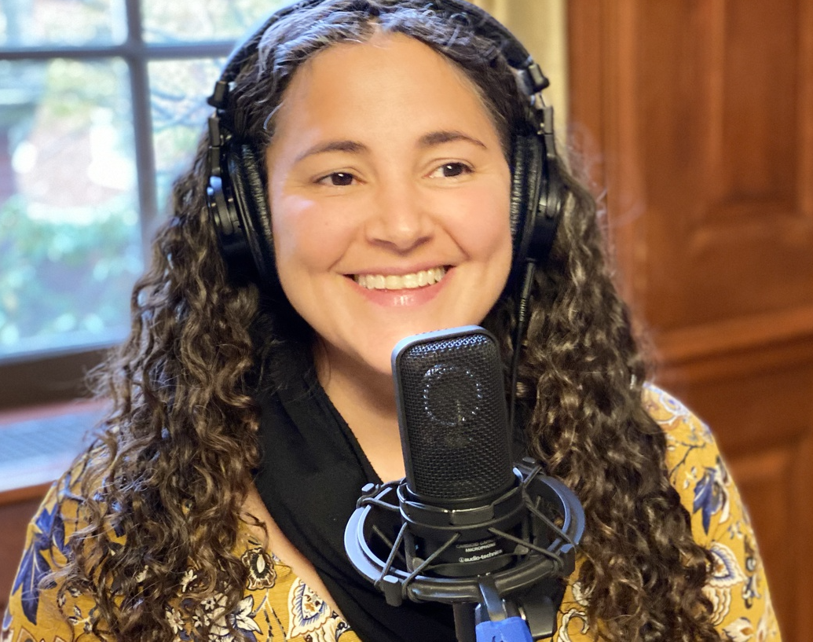
I DON’T
suggest:
Checking your phone..
“Are you using social media
instead of connecting
with people in real life?”
Paraphrase of Laurie Santos, Life Examined: Why is it so hard to be happy.
KCRW (Los Angeles) Podcast, March 19, 2022.
Solen Feyessa
@ Unsplash

Slide 13
I DON’T
suggest:
Why
phones
make
people
Sad ☹
Checking your phone..
“Everyone compares
themselves to others
Solen Feyessa
@ Unsplash

Slide 14
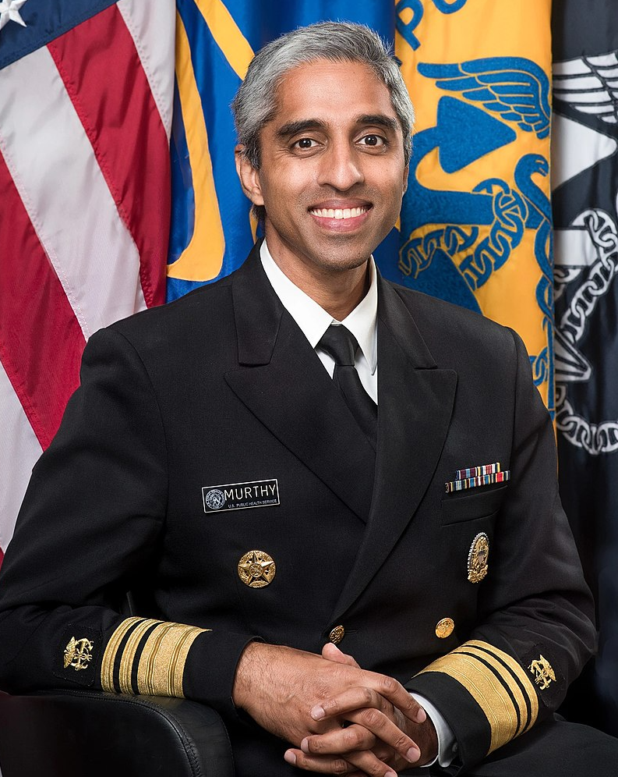
I DON’T
suggest:
Checking your phone..
“Online you compare
your ‘average’ to
other people’s ‘best’ ”
Paraphrase from
U.S.Surgeon General Vivek Murthy
Solen Feyessa
@ Unsplash
Leading with empaty. The Atlantic Pursuit of Happiness Conference, May, 2021

Slide 15
More
on
phones?
Solen Feyessa
@ Unsplash

