Slide 1
Welcome
to your
brain
© 2020 Marc Helgesen
marchelgesen@gmail.com
May be used with students.
Small portions may be use in non-commercial teacher development sessions with attribution.
Most photos © clipart.com. Used under license

Slide 2
Welcome
to your
brain

Slide 3
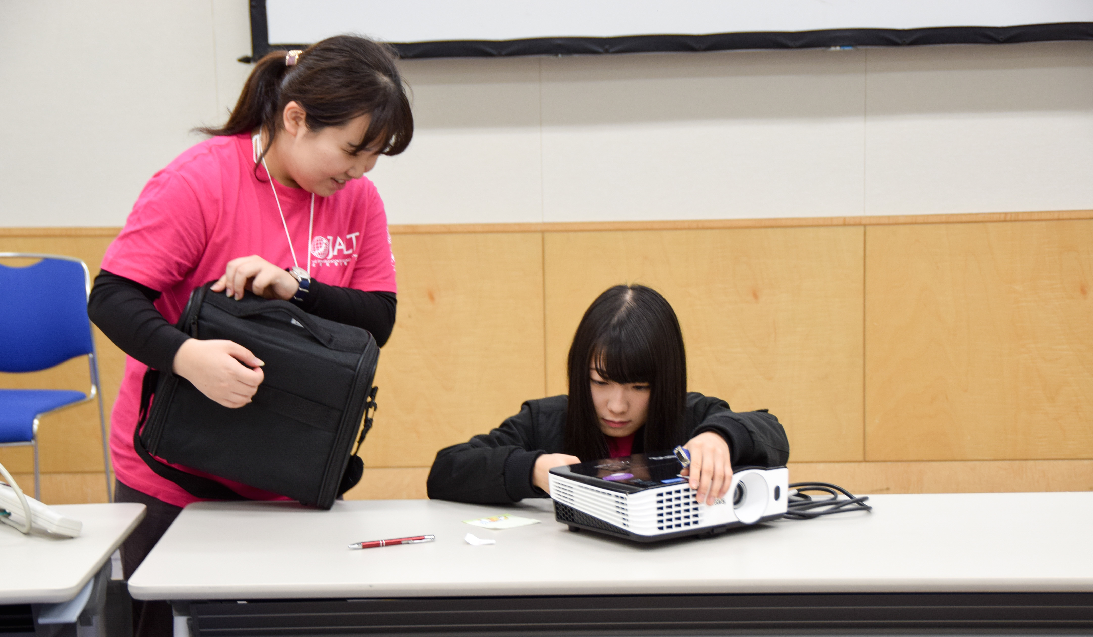
Please take a minute to thank Pink Shirt interns.
Better yet,
have a 2-3
minute
conversation.
They help us
so much.
Appreciate
them!

Slide 4
Welcome
to your
brain

Slide 8
This is your brain
on happiness

Slide 9
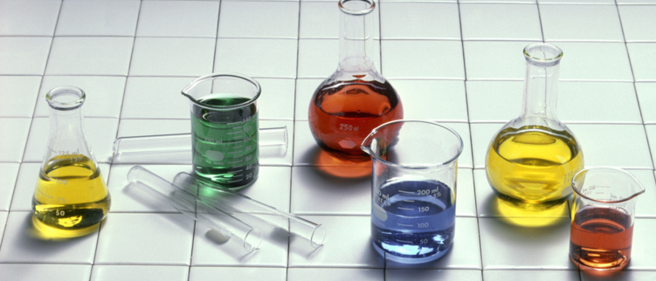
This is your brain
on happiness
oxytocin
endorphin
a chemical story
serotonin
dopamine
BDNF
cortisol
Notes:
Dopamine N, Sero N (but present in blood so H also, Oxy, H and N, Endor H, BDNF protein

Slide 10
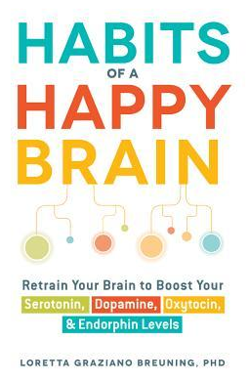
Inner Mammal Institute
Prof. Emerita
California State Uni.
– East Bay
Notes:
Neuro biology
My background has been cognitive psychology.

Slide 11
“…everything really
influences
everything else…”
- Tracey Tokuhama-Espinosa

Slide 13
X¹
X
5 pictures: Good things
in Marc’s life
Notes:
What would your pictures be?
Photo credit:http://propakistani.pk/2012/07/26/how-to-check-if-your-cell-phone-pictures-are-being-monitored/

Slide 14
BBQ

Slide 15
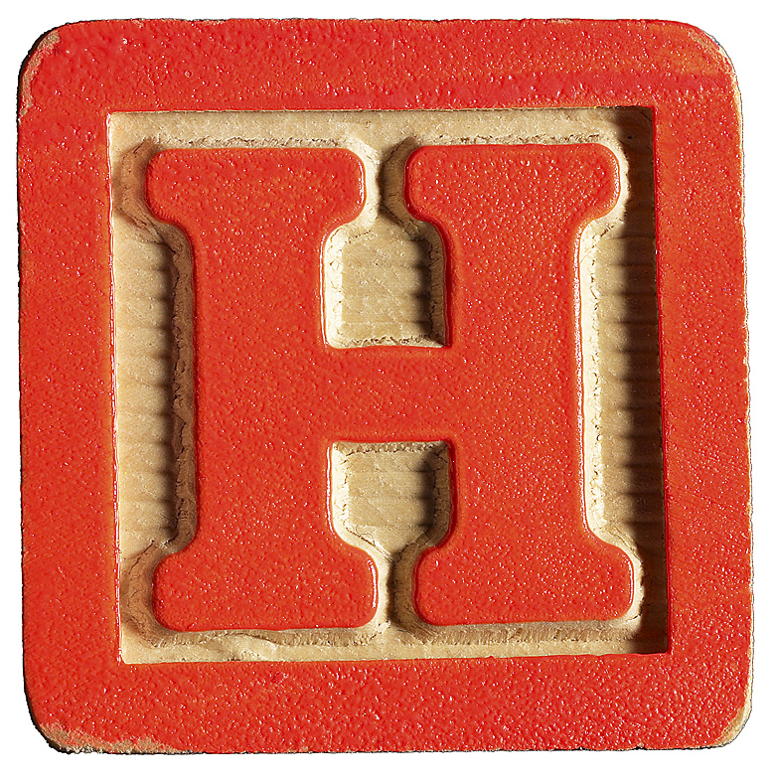
’
Discourse strategy
Keep the conversation going
Notes:
“Active – Constructive” responses – They help the partner mentally recreate the emotion
-- good psychologically
-- good conversation strategy

Slide 16
’
Positive psychology:
Active Constructive Response
Notes:
“Active – Constructive” responses – They help the partner mentally recreate the emotion
-- good psychologically
-- good conversation strategy

Slide 17
’
Your partner got a job promotion.
Active
Constructive
Wow. Great.
Tell me all
about it.
Passive
Constructive
Wow. Great.
That’s nice.
Active Destructive
Oh. Now you are
going to be even
busier than now.
Passive Destructive
That’s nice.
What’s for dinner?
_
_
Notes:
“Active – Constructive” responses – They help the partner mentally recreate the emotion
-- good psychologically
-- good conversation strategy
Promotion - Active constructive – Wow. Tell me all about it.
Passive constructive – That’s nice.
Passive destructive – That’s nice. What’s for dinner.
Active destructive – Oh great. Now you’re going to be even busier.

Slide 19
Imagine the picture.
Describe it

Slide 21
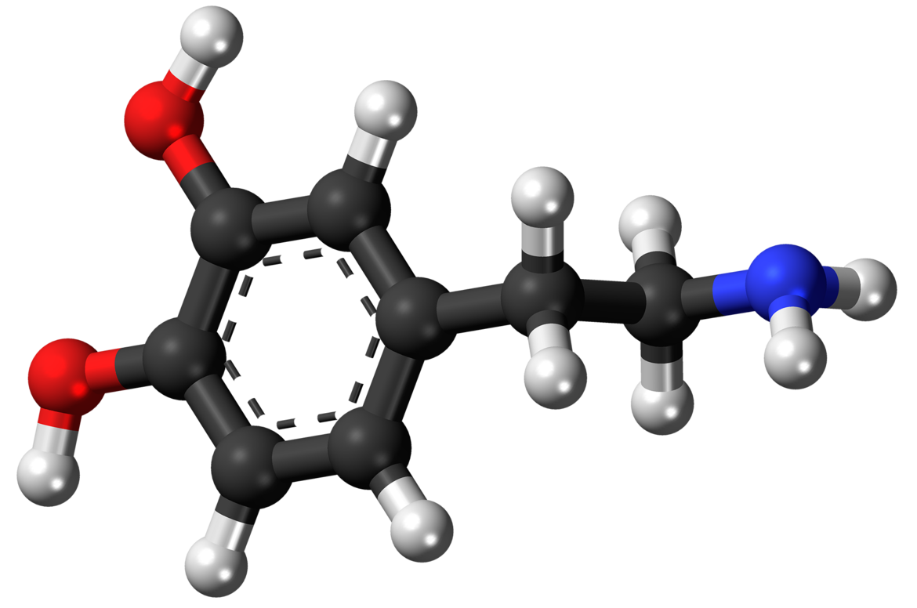
dopamine

Slide 22
dopamine
memory
motivation
focus

Slide 23
Emotion triggers dopamine

Slide 24
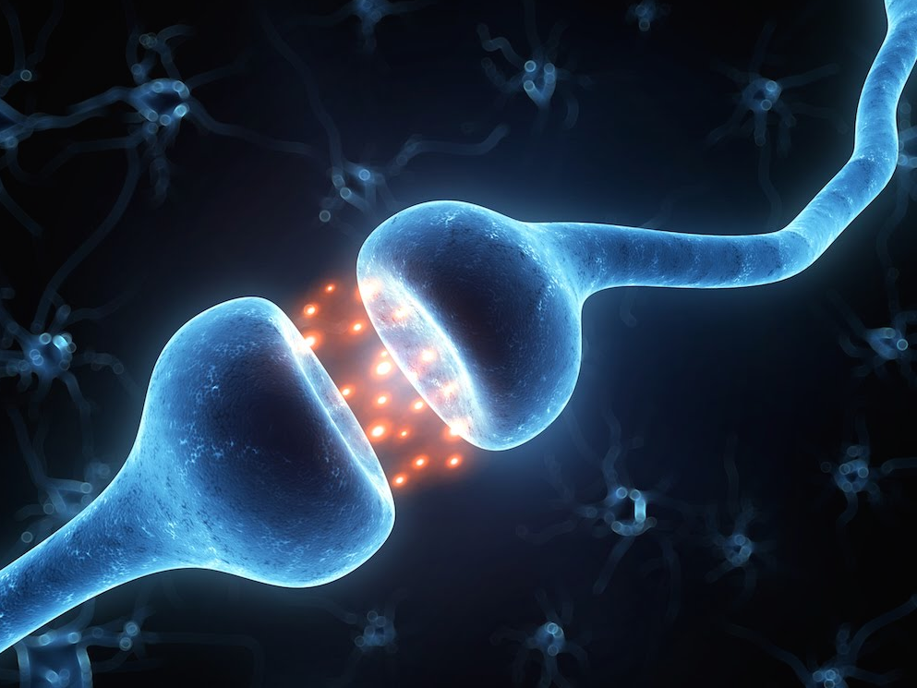
To make synapse efficient
slowly
repetition
Image: biology4alevel.blogspot.jp/
Notes:
http://biology4alevel.blogspot.jp/

Slide 25
To make synapse efficient
quickly
emotion
Image: biology4alevel.blogspot.jp/
Notes:
http://biology4alevel.blogspot.jp/

Slide 26
Other
dopamine
triggers
pleasure
sleep
exercise
goal completion
Notes:
Pleasure – cocaine – more dopamine than real life. That’s why so addictive

Slide 27
Today’s goals:
-
-
-
-
Celebrate
small
victories.
Notes:
June/July, go back. Play unit 1 listening again.
July-ish. When they’ve done something like a 15-20 minute task, almost all in English. Point it out.
Point out their effort.

Slide 28
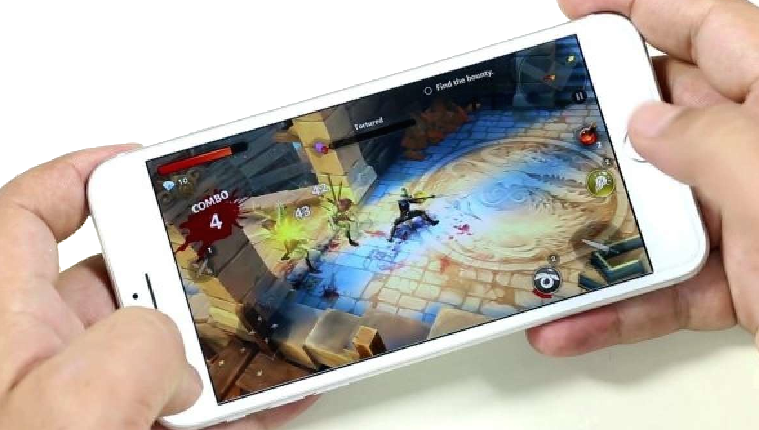
Stress but
small rewards
Notes:
Masters of challenge?

Slide 29
Cliffhangers
Notes:
Why so important?
I’ll tell you later.
Keeps them paying attention
(keeps them wanting more (motivation). Stories – start it, come back to it. EMOTION

Slide 30
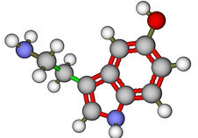
serotonin

Slide 31
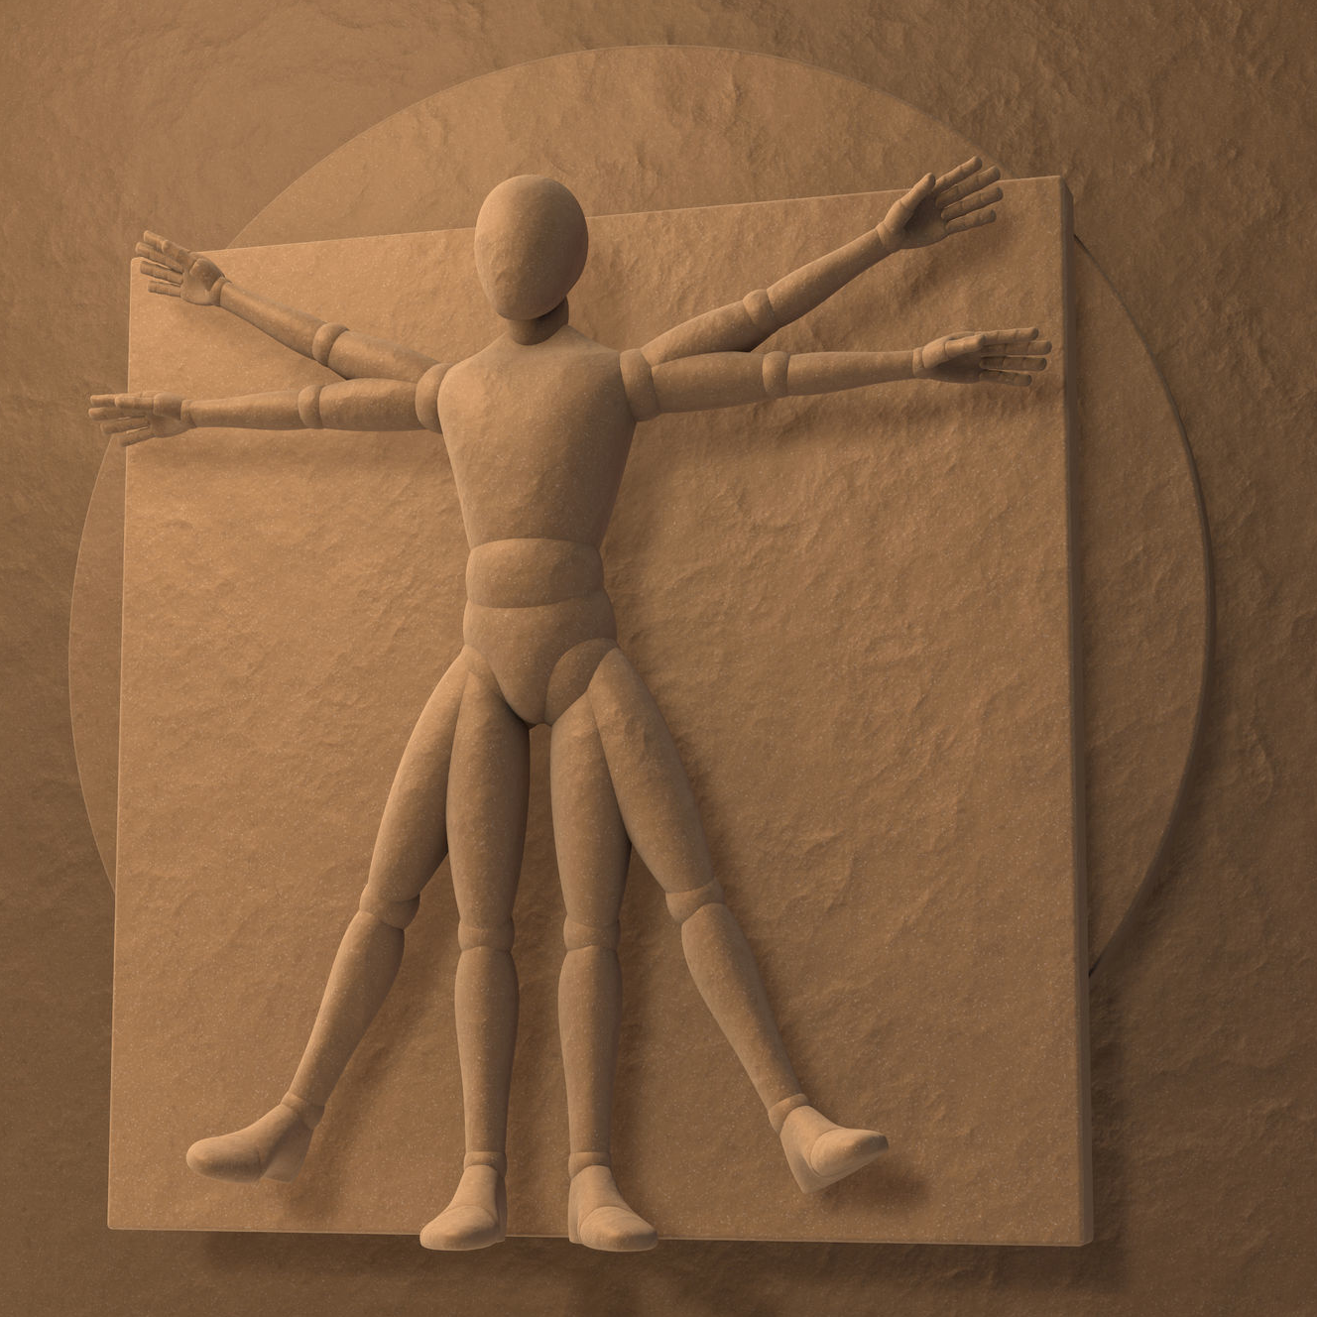
Your
body
is
like a
“second brain”
Especially
the “gut”
where many
neurons are
located
Notes:
Second brain: separate nervous system. So complex, like a 2nd brain.

Slide 32
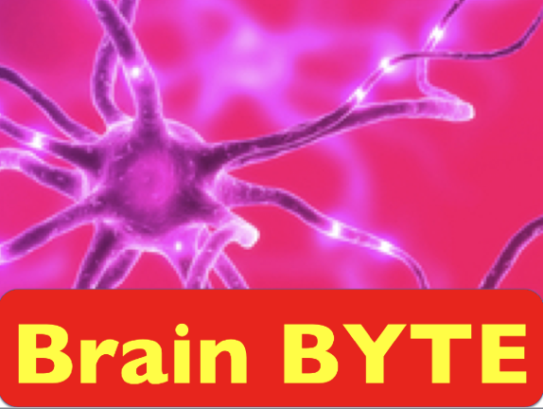
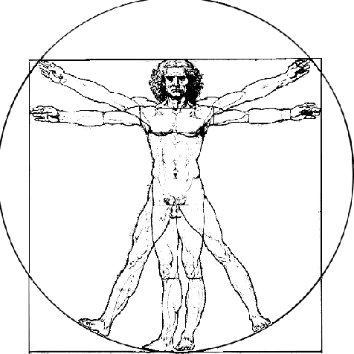
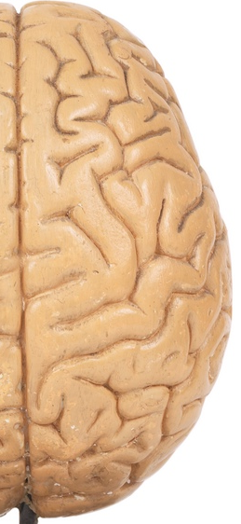
Your brain Your body
Neurons:
85 billion 500 million
85,000,000,000
Neurotransmitters
identified:
> 100 > 40
500,000,000
Dopamine production:
50% 50%
Serotonin production
5% 95%
Source: New Scientist & neuroscience
stuff.tumblr.com
Both affect blood flow
Notes:
http://neurosciencestuff.tumblr.com/post/38271759345/gut-instincts-the-secrets-of-your-second-brain
(8byaku 5-ju oku. Body, 5 oku

Slide 33
Serotonin
triggers
bright light
exercise
meditation
feeling respected
Notes:
Exercise triggers tryptophan – which is needed to produce serotonin.

Slide 34
Yoga
breathing
Insert video
in through
the nose
out though mouth
out though the mouth
Notes:
Normal breathing: 300-500 ML of air. 2500 ML of residual air. Trying to force that out.

Slide 35
Yoga
breathing
Insert video
OUT - 2-3-4-5-6
Hold - 2-3-4-5
IN - 2-3-4
out though mouth
Hold - 2-3-4-5
Notes:
Pairwork, then teach other pair

Slide 36
Yoga Breathing
Before tests
Before job
interviews
Before presentations
Any time they
want to
control their
body/mind
Notes:
I teach for use before tests, (inc. TOIEC etc.
Normal breathing: 300-500 ML of air. 2500 ML of residual air. Trying to force that out.

Slide 37
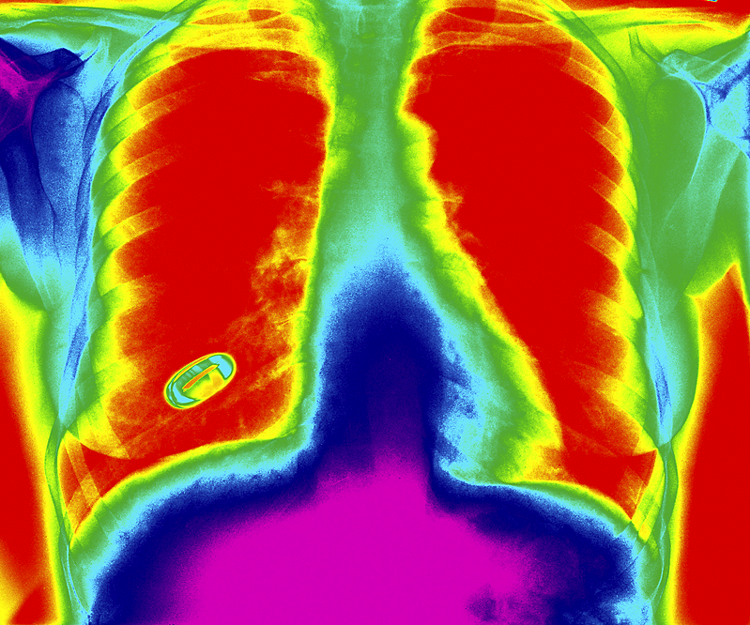
Yoga Breathing
Private,
in public.
Notes:
I teach for use before tests, (inc. TOIEC etc.
Normal breathing: 300-500 ML of air. 2500 ML of residual air. Trying to force that out.

Slide 38
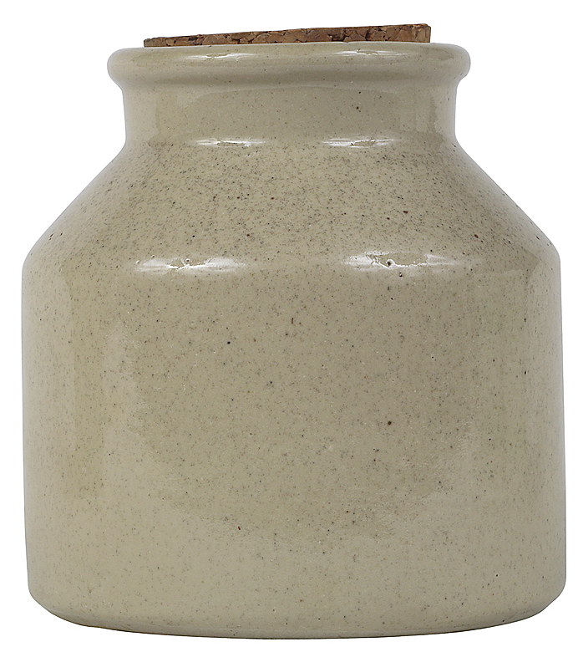
savo
savoring

Slide 39
savo
savoring
“to attend to,
appreciate,
and enhance
positive experiences”
- Bryant & Veroff
Notes:
Fred Bryant

Slide 40
Remembering
positive
events
triggers
serotonin
What did you
do over
the weekend
?
that was
really good?

Slide 41
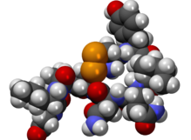
Oxytocin
The cuddle chemical
The hugging hormone
Notes:
Some are neurotransmitter – in nervous system.
Some are hormones – in blood.
Some do both.

Slide 42
touching

Slide 43
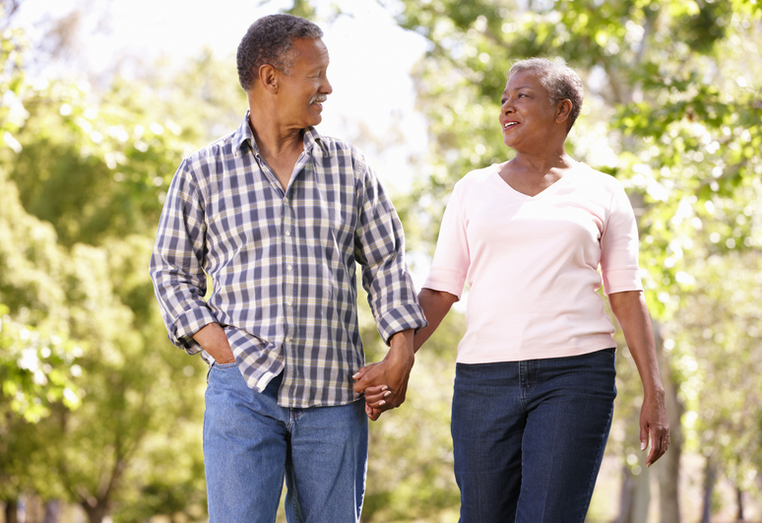

Slide 44
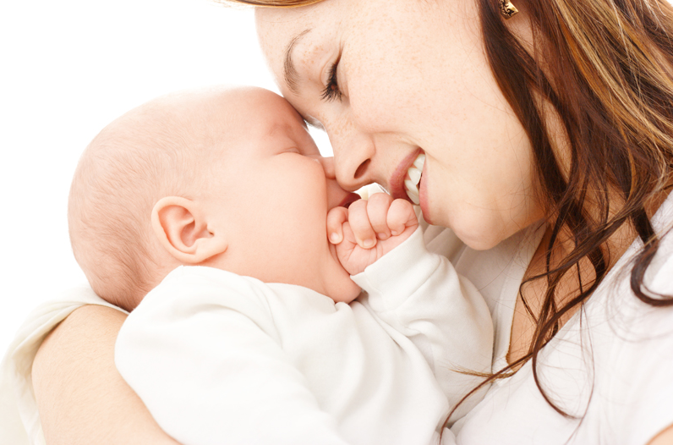
bonding

Slide 45
With
fur babies,
too
Notes:
http://www.sciencemag.org/news/2015/04/how-dogs-stole-our-hearts

Slide 46
Play this video:
https://www.youtube.com/watch?v=DLu2CFDBJk0
Notes:
https://www.youtube.com/watch?v=DLu2CFDBJk0

Slide 47
With
fur babies,
too
Notes:
http://www.sciencemag.org/news/2015/04/how-dogs-stole-our-hearts

Slide 48
Notes:
6-8 billion dollars a year.

Slide 49
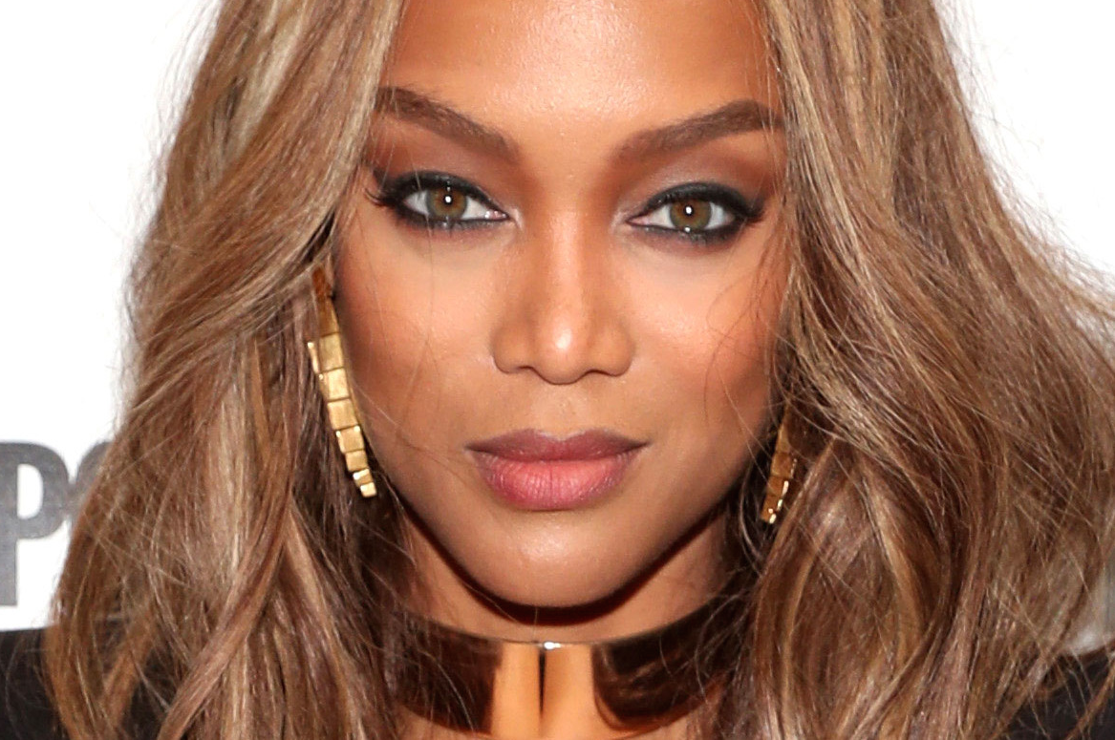
Tyra Banks
Smize
Notes:
TV personality, model

Slide 50
Play a cut from this video. 0:10 – 0:29
https://www.youtube.com/watch?v=EBharOWh4xM
Notes:
Cut after “nice smize, tyra.” https://www.youtube.com/watch?v=EBharOWh4xM

Slide 51
Note – Smize is NOT the science.
We’ll get to that in a minute.

Slide 52
Let’s try.
Stand up.
Face a partner.
Mouth neutral.
Squint a little.
Smile with your eyes.

Slide 53
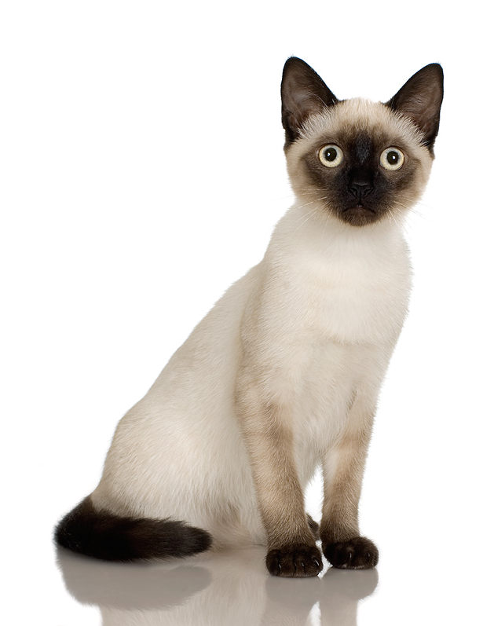
Eye contact

Slide 54
Eye contact
triggers oxytocin
Notes:
Stop after 1 minute.
4 minutes – you’ll fall in love. (Arthur Aron Stony Brook, 90’s). Zick Rubin 70’s
(80% of neurons connect to vision). https://www.theguardian.com/intimacy-secrets-for-all/2017/jun/01/can-eye-contact-make-you-fall-in-love

Slide 55
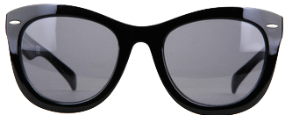
The dark side
Oxytocin

Slide 56
Envy &
jealousy

Slide 57
Tribalism

Slide 58
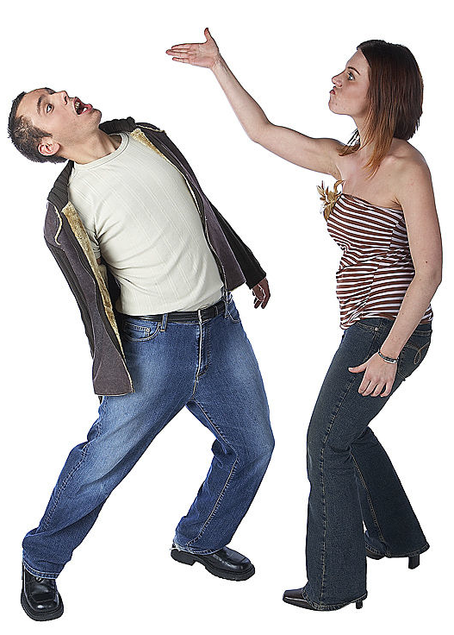
Violence
in aggressive people

Slide 60
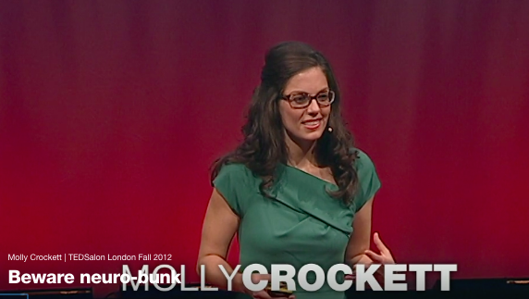

Slide 61
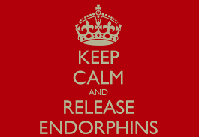

Slide 62
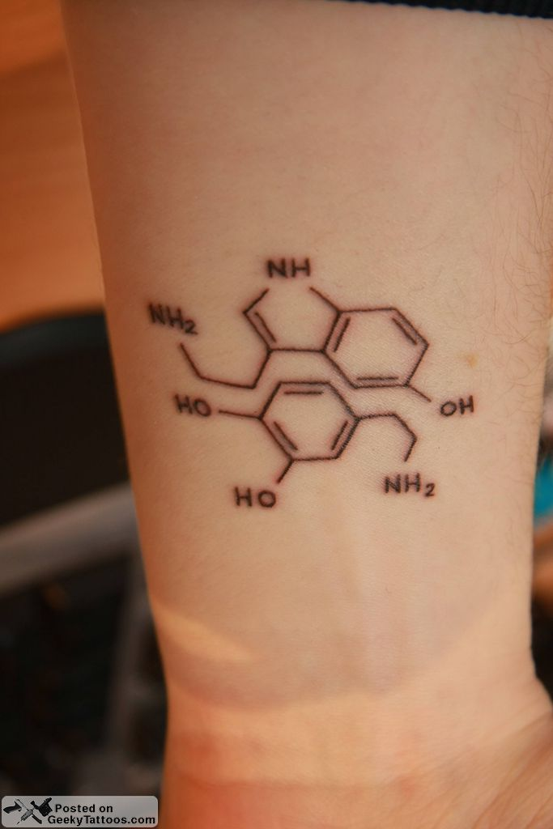
Nature’s
pain killer

Slide 63
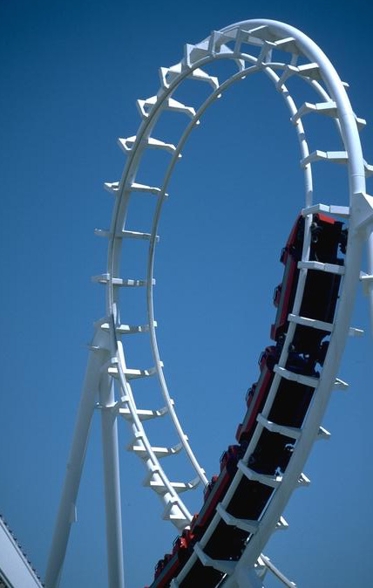
Like
roller
coasters?

Slide 64
Short video of roller coaster drop
Notes:
Short video of roller coaster drop

Slide 65
That’s not
endorphin.
That’s
adrenalin.
(ephinephrine)
+ cortisol
Notes:
Fight or flight (freeze) response .. No pain yet.

Slide 66
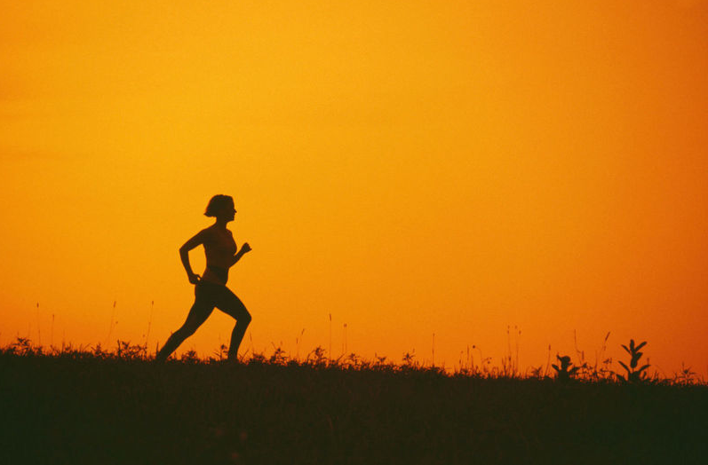
Runner’s high
Masks pain.
20 minutes
Notes:
Adrenalin about 2 minutes

Slide 67
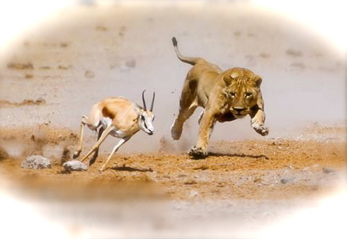
Image: andyellowood
Notes:
Gazelle and lion. Gazelle gets bit – pain killer – let’s run away injured. If can’t get away, less pain in death.

Slide 68
DIY – Do it yourself
Endorphin
Laugh
Cry (or tear up)
Eat spicy food

Slide 69
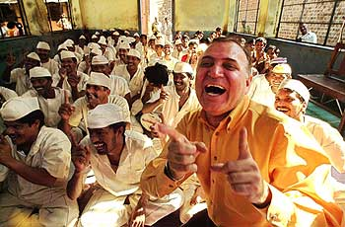
Laughter yoga
Notes:
Laugh for no reason Dr. Madan KaTAria
Laughter PLUS Yoga.
Breathing: Normal 300-500 milliliters of air
2500 ML of residual air. Laughter forces it out.

Slide 70
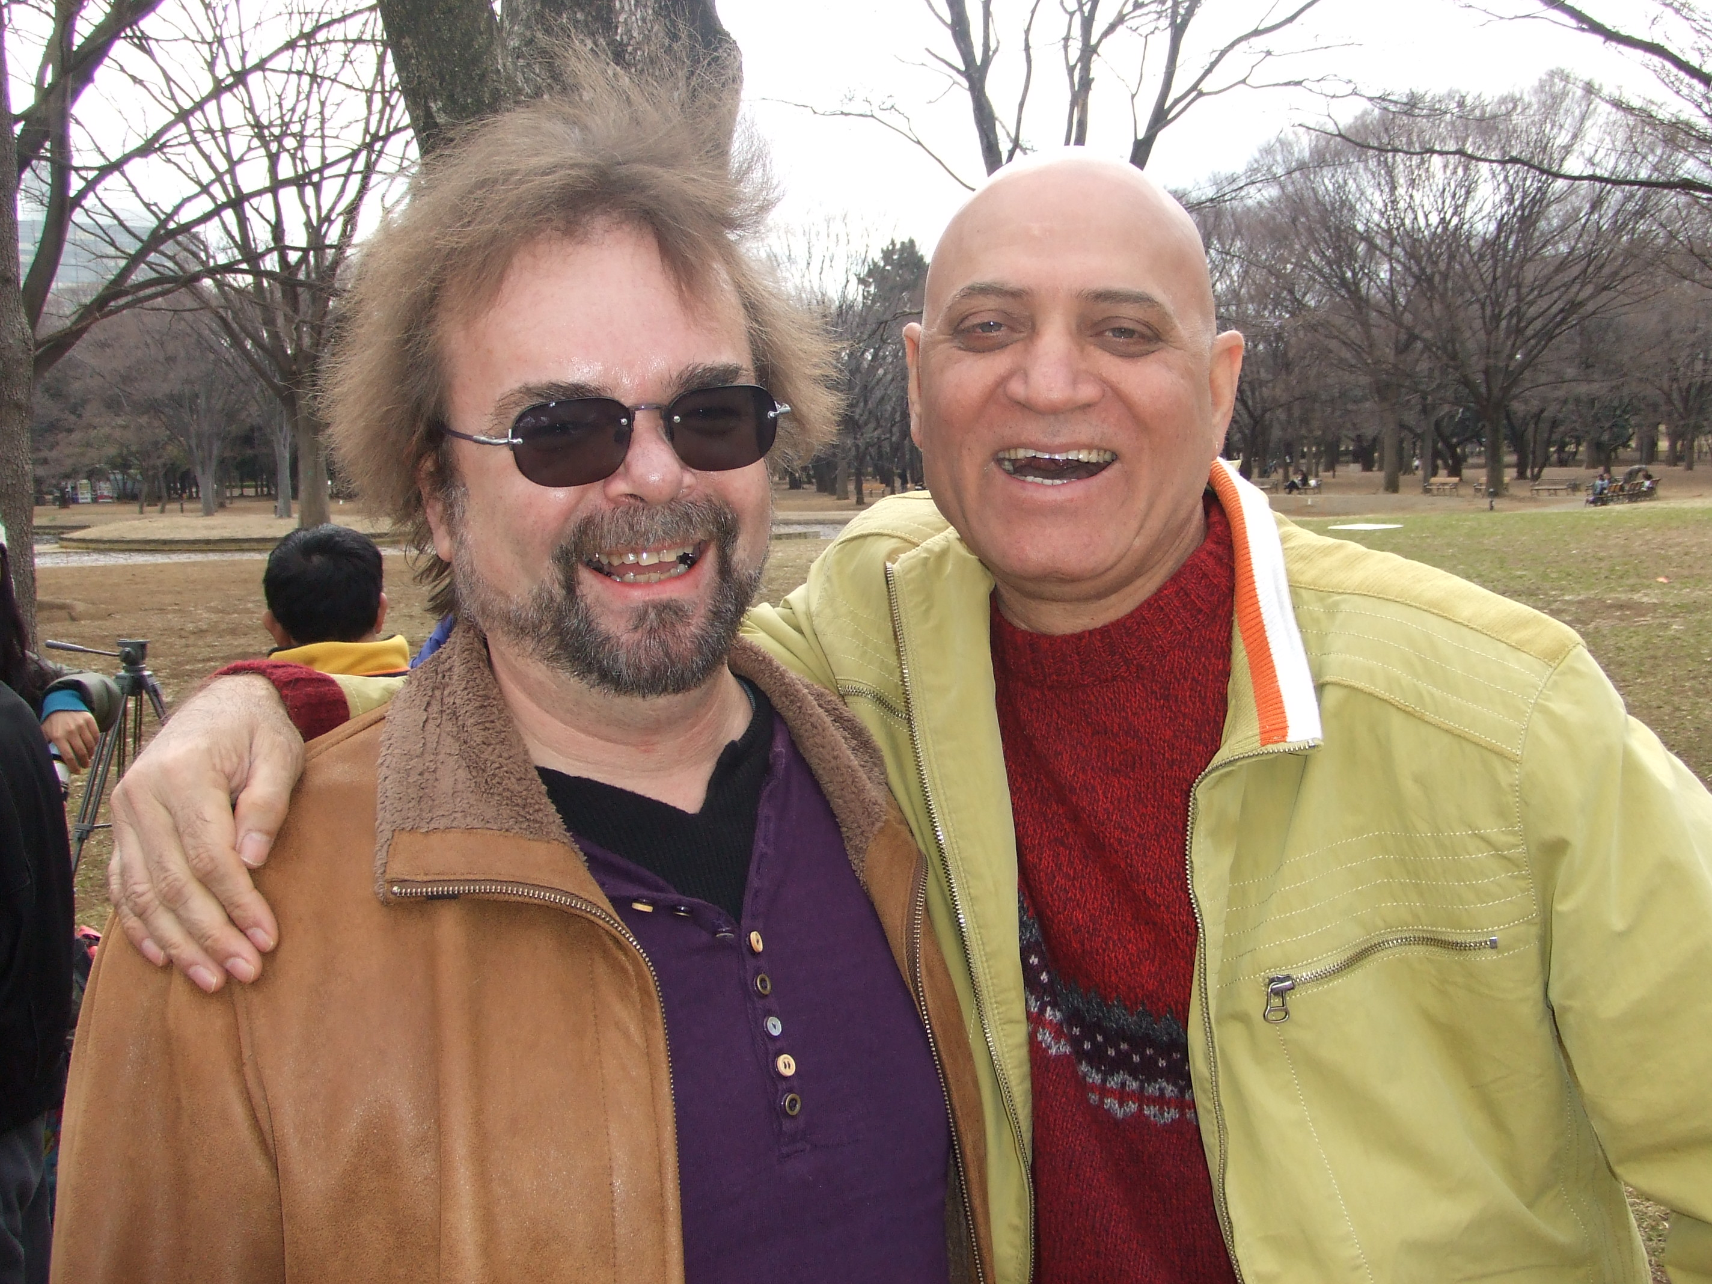

Slide 71
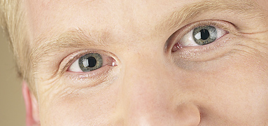
clap
eye contact
Fake it
‘til you
make it
Notes:
1, eye contact -- Laughter is contagious
2. Clap – motion – creates emotion Palm 2 palm
3. Fake it ‘til you make it.

Slide 72
Ho. Ho.
Ha! Ha! Ha!
Notes:
this. Followed by “very good. Very good. Yeah! (affirmation – self-fulfilling prophesy
Milk shake laugh 3. cell phone laugh 4. Subway (squeeze together)
(If time) Why are you laughing (clueless). (pass the laugh (I’m laughing and I have no reason).

Slide 73
Laughter practice
Beth Agnew
www.laughpractice.blogspot.com
Notes:
https://www.youtube.com/watch?v=jknMEqLnepI

Slide 74
Laughter practice
https://www.youtube.com/watch?v=jknMEqLnepI&t=7s

Slide 75
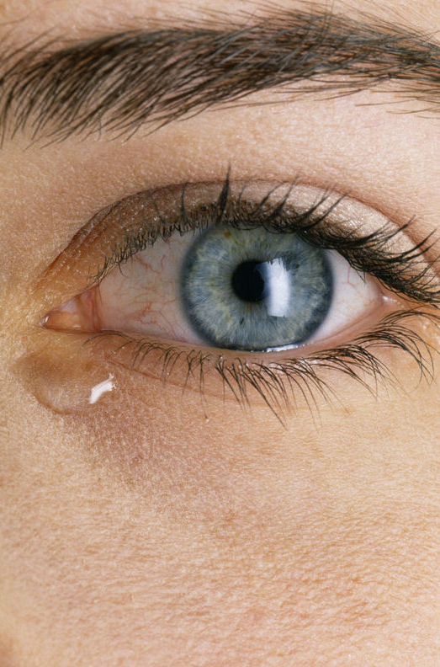
Stories
that touch
your heart.

Slide 76
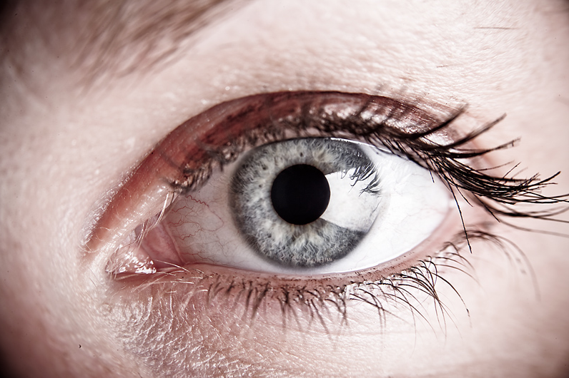
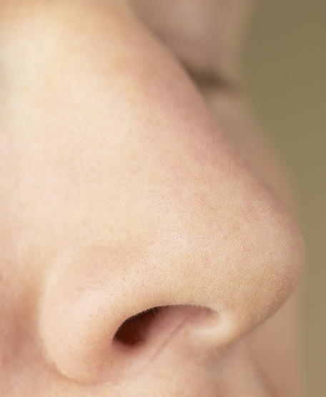
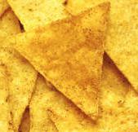
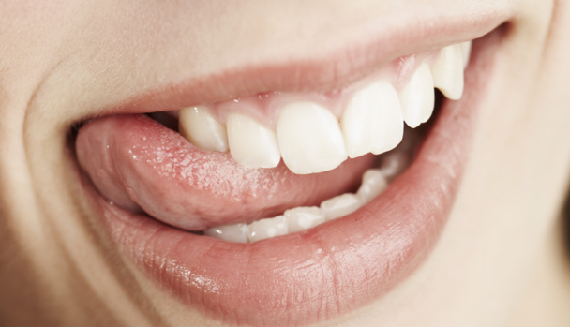
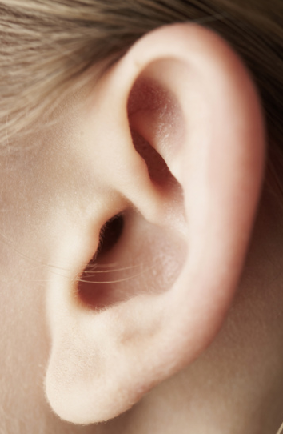
Eating
with
mindfulness
slowly
Spicy →
Notes:
76
Check McGurk, Willingham, drumpad
Set Active Teach
Delighted/excited.
Who are you?
Every bit of info we take in we do so through the senses.

Slide 77
DIY – Do it yourself
Endorphin
Laugh
Cry (or tear up)
Eat spicy food

Slide 78
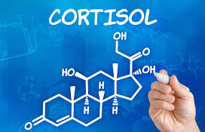
Scares you:
touching fire
Avoid fights
you’ll lose.
Parent
protecting child.
Notes:
Fight/fright/ freeze response.
Point.

Slide 79
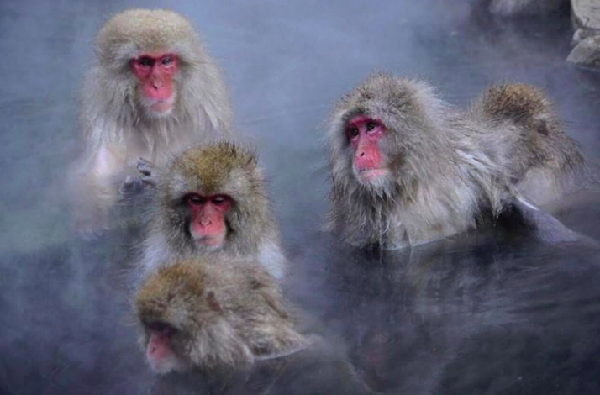
20% less cortisol
when bathing
in winter
Photo: Rafaela Takeshita
Japan News
Notes:
Yamanouchi, Nagano-ken
Japan News, April 4, 2018 p. 3

Slide 80
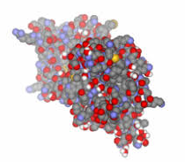
BDNF
Brain-Derived
Neurotrophic Factor

Slide 81
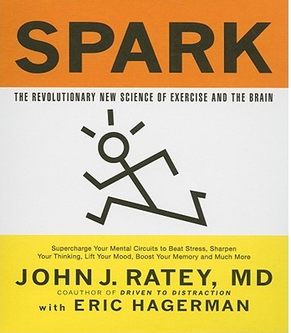
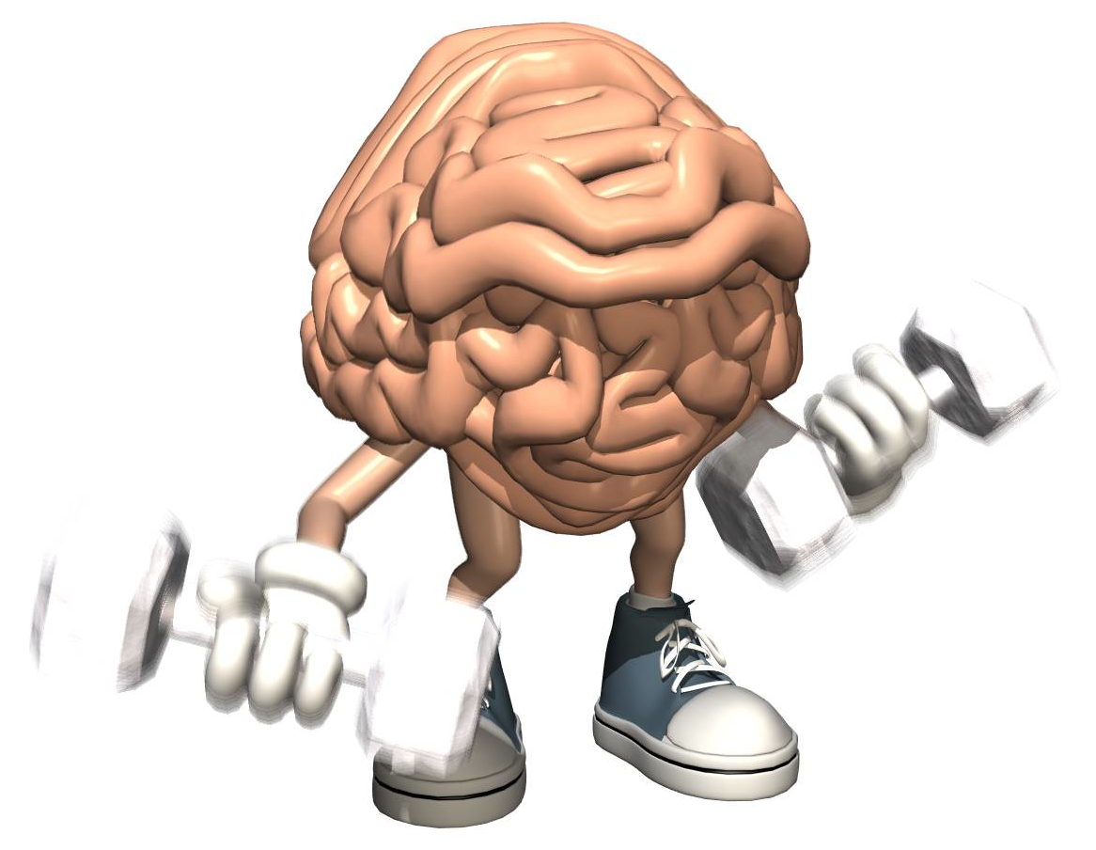
Exercise increases BDNF
肥料
“Miracle-Gro
For the Brain”
- John Ratey
Harvard
Hiryo
Notes:
Hiryo
Protein – biological link between thought, emotion and movement.
Increases voltage in brain.
Brain Derived Neurotrophic Function

Slide 82
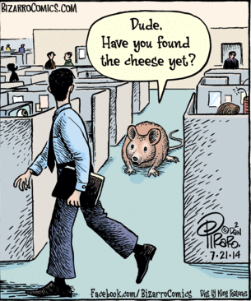
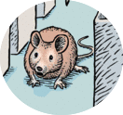
Lab rats –
Aerobic
exercise,
learn
mazes
2 – 12 x
faster
http://depts.washington.edu/adrcweb/BuchnerPresentation061307.pdf

Slide 83
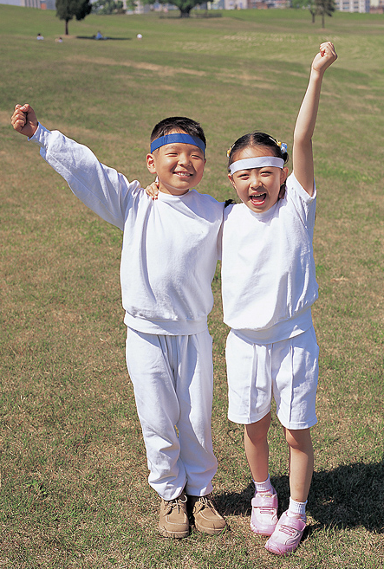
Schools
with PE
classes,
students
better on
science &
math tests.
Notes:
Spark. John Ratey

Slide 84
After
exercise,
20% faster
learning
vocabulary.
2007 German study, cited in: High impact running improves learning B. Winter, et al
Neurobiology of Learning and Memory 87 (2007) 597–609
Notes:
High impact running improves learning B. Winter, et al
Neurobiology of Learning and Memory 87 (2007) 597–609
www.elsevier.com/locate/ynlme
Bernward Winter a,¤,1, Caterina Breitenstein a,b,1, Frank C. Mooren c, Klaus Voelker d, Manfred Fobker e, Anja Lechtermann d, Karsten Krueger c, Albert Fromme d, Catharina Korsukewitz a, Agnes Floel a, Stefan Knecht
2007 German study, cited in:
http://time.com/12086/how-to-make-your-kids-smarter-10-steps-backed-by-science/

Slide 85
Wendy Suzuki, PhD
Neuroscientist
New York
University

Slide 86
Watch.
Do what she does.
Repeat what
she says.

Slide 87
Wendy Suzuki TED talk 11:15 – 12:55
https://www.youtube.com/watch?v=BHY0FxzoKZE&t=2s
Notes:
11:41

Slide 88
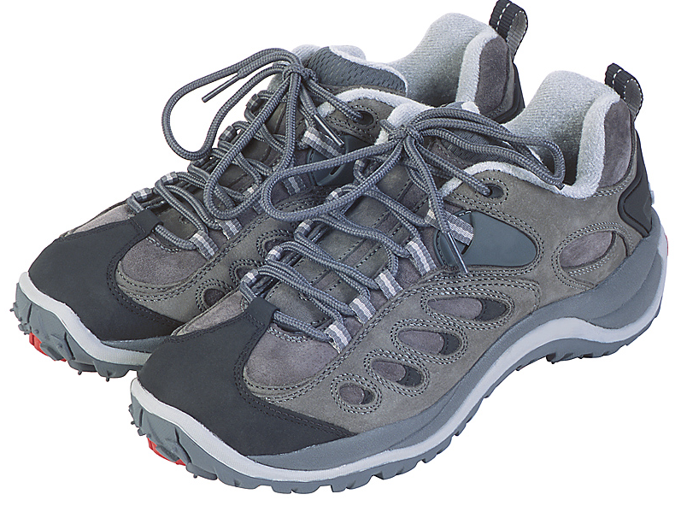
Single workout:
Increases reaction time
Increases dopamine,
serotonin,
noradrenaline (+mood)
Increases ability to shift,
focus attention.

Slide 89
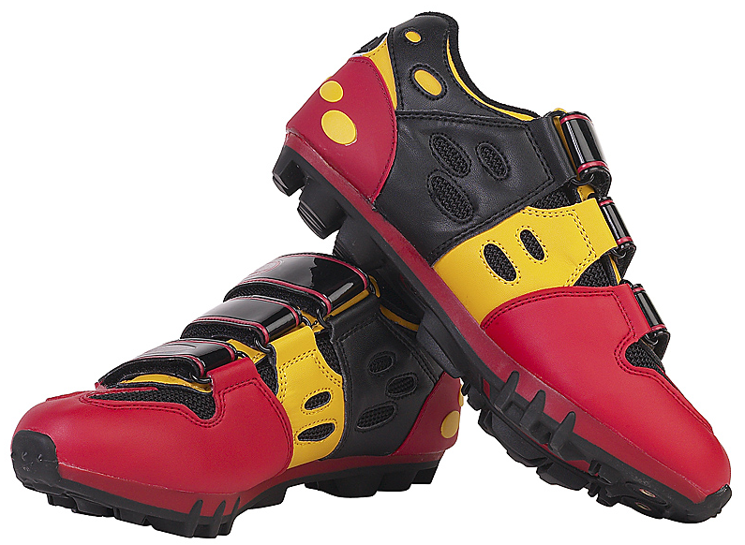
Long-term:
Increases attention
& + mood
Increases volume of
brain cells in hippocampus
(memory)
serotonin,
Noradrenaline
Protects brain (hippocampus,
PFC) from aging
Notes:
3-4 times a week. 30 min. Includes aerobic

Slide 90
Energy break

Slide 91
This is your brain
on happiness
Thank you.

Slide 92
Thanks to
for sponsoring me this year

Slide 94
Usually
3650 yen
During JALT
2500 yen
+ pack of 5 emoji balloons + activities

Slide 95
This is your brain
on happiness
Thank you.

