Slide 1
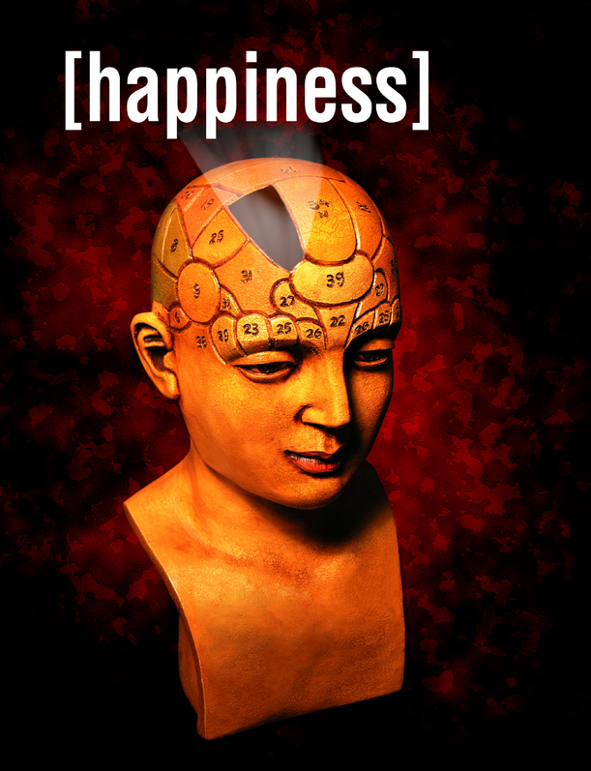
S
ELT & the science of
Positive
psychology
in the
language classroom
©Marc Helgesen
www.ELTandHappiness.com

Slide 2
Forgive
Learn to forgive
Notes:
Learn to Forgive.
Forgive others. Forgive yourself.

Slide 3
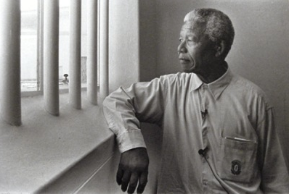
Not to forgive is like
drinking poison
and then hoping it will
kill your enemies.
- Nelson Mandela
Notes:
27 years in prison
Every right, every reason to hate the people. But he said: (CLICK)

Slide 4
Forgive
Think of people who have hurt you. Who DIDN’T you forgive yet?
Put one arm
straight out.
Hold something heavy.
Notes:
Note to teacher.
Make sure they know they won’t be asked to talk about the bad thing (it may be private).
Also give them time to think of something specific.

Slide 5
 Read this silently. Your teacher will read it aloud:
Someone did something bad to you.
Forgiveness does NOT mean it was OK.
Forgiveness does NOT mean that person can do it again.
Forgiveness is important for things that must NOT be done again.
Notes:
Note to teacher. Read this is a slow, calm voice. Give them time to think about each line.

Slide 6
When you do not forgive, who is hurt?
The person who did the bad thing usually doesn’t know.
Or doesn’t remember.
Or doesn’t care.

Slide 7
You carry the weight.
It does not help to know why the person did the bad thing.
The anger is in your heart.
- Usually that person
doesn’t know.

Slide 8
Heavy, isn’t it?
You carry the weight.
You have the power to
let it go.

Slide 9
Forgive
You have the power to
let the hurt go.
Metaphor can teach
things we can’t
teach directly.

Slide 10
Forgiveness - the science
Studies of university students thinking
about “hurtful memories” found those
who forgive others have:
- less stress
- healthier body functions (heart rate,
blood pressure, EMG (electromyogram -- tests nerve/muscle function))
Forgiving others also seems connected to less:
• anger • depression
• negative thoughts • alcohol/drug abuse
https://www.amsa.org/healingthehealer/forgiveness.cfm
American Medical Association Student Association

Slide 12
Forgive
Forgive
Notes:
Learn to Forgive.
Forgive others. Forgive yourself.
Note to teachers: as a follow-up, you might want to use “forgiveness quotations”. Students read six quotations/proverbs about forgiveness and rate them. Free at: http://www.eltandhappiness.com/uploads/1/1/2/5/11251138/forgive_quotes10_min._for_happiness.pdf

