Slide 1
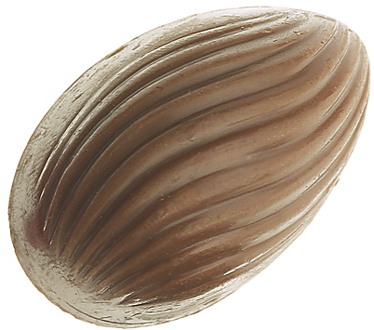
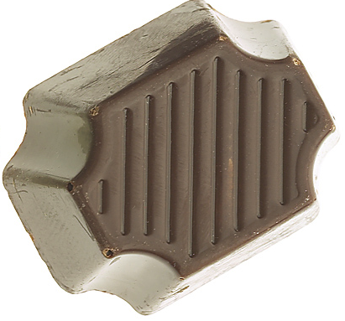
#1. Students get two pieces of candy.
They eat one with slowly with
mindfulness.
Enjoy it.
#2. Then I ask:
What could you do that would
make someone else happy?
Maybe surprise someone?

Slide 2
Be creative:
• Someone you don’t know.
(You look kind of sad. Have this.)
• Who helps you
at school?
(office staff?
cleaning staff?
guards? bus drivers?)

Slide 3
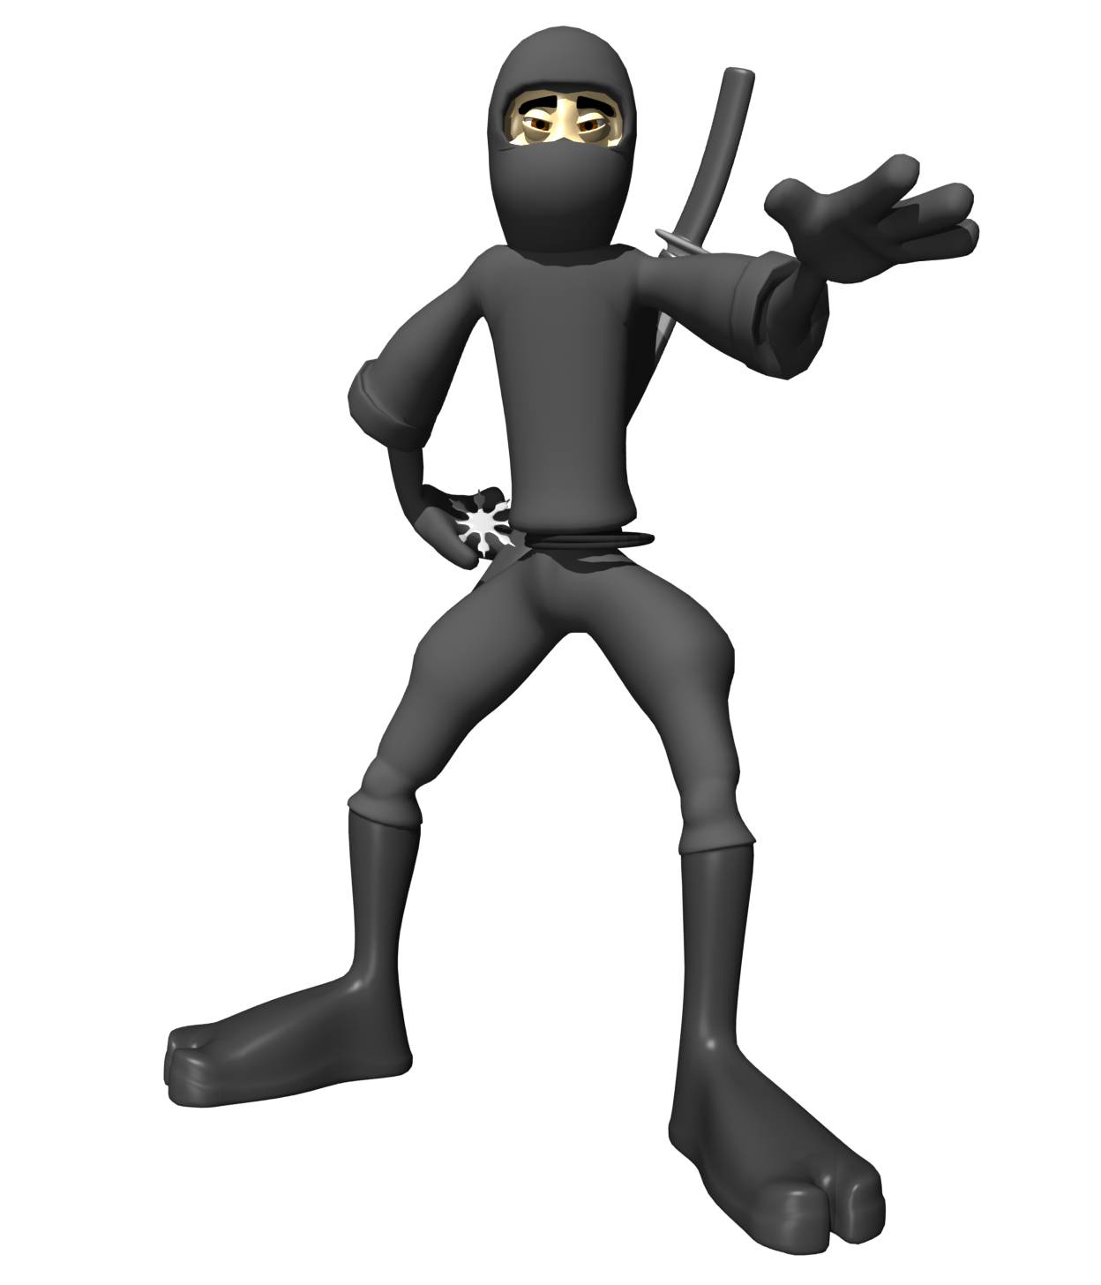
My favorite:
Choco Ninja!
おやつの時間です。 どうぞ

Slide 4
My favorite:
Choco Ninja!
Snack time. Enjoy!
Then disappear

