Slide 1
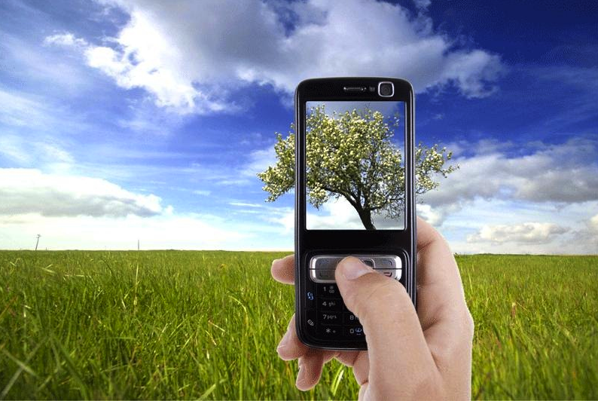
5 pictures: Good things
in Marc’s life
Notes:
What would your pictures be?
Photo credit:http://propakistani.pk/2012/07/26/how-to-check-if-your-cell-phone-pictures-are-being-monitored/

Slide 2
My Students

Slide 3
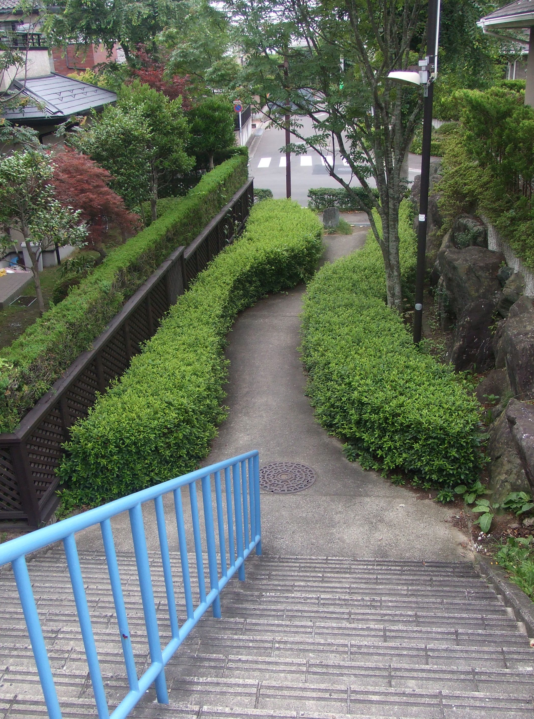
Walking &
wabi sabi
Notes:
Walk to work 2x week. Go through a couple parks. Love wabi sabi

Slide 4
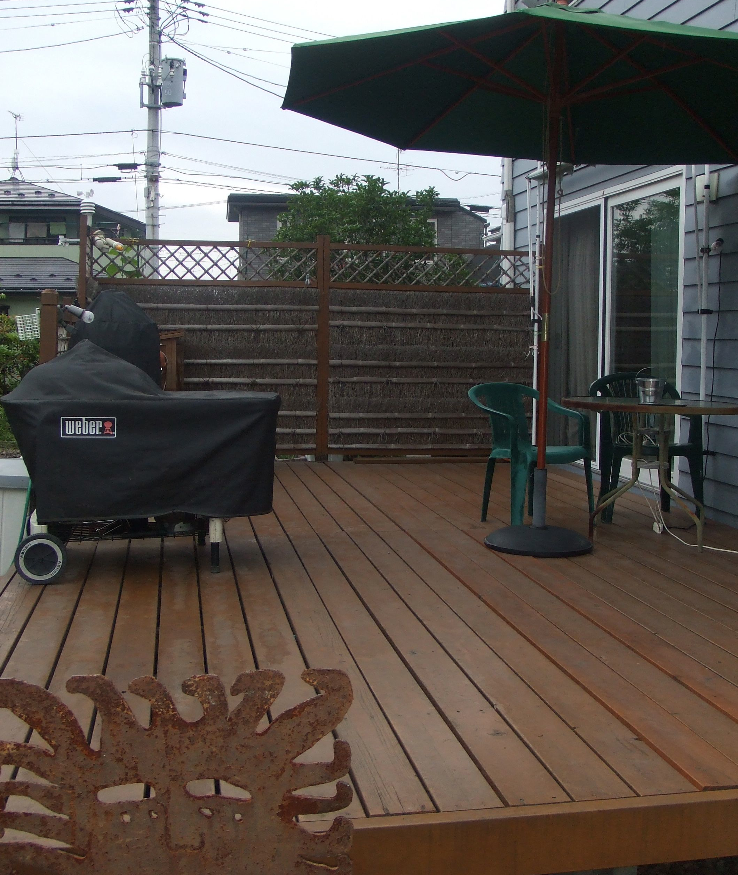
My deck:
a good place to hang out

Slide 5
BBQ

Slide 6
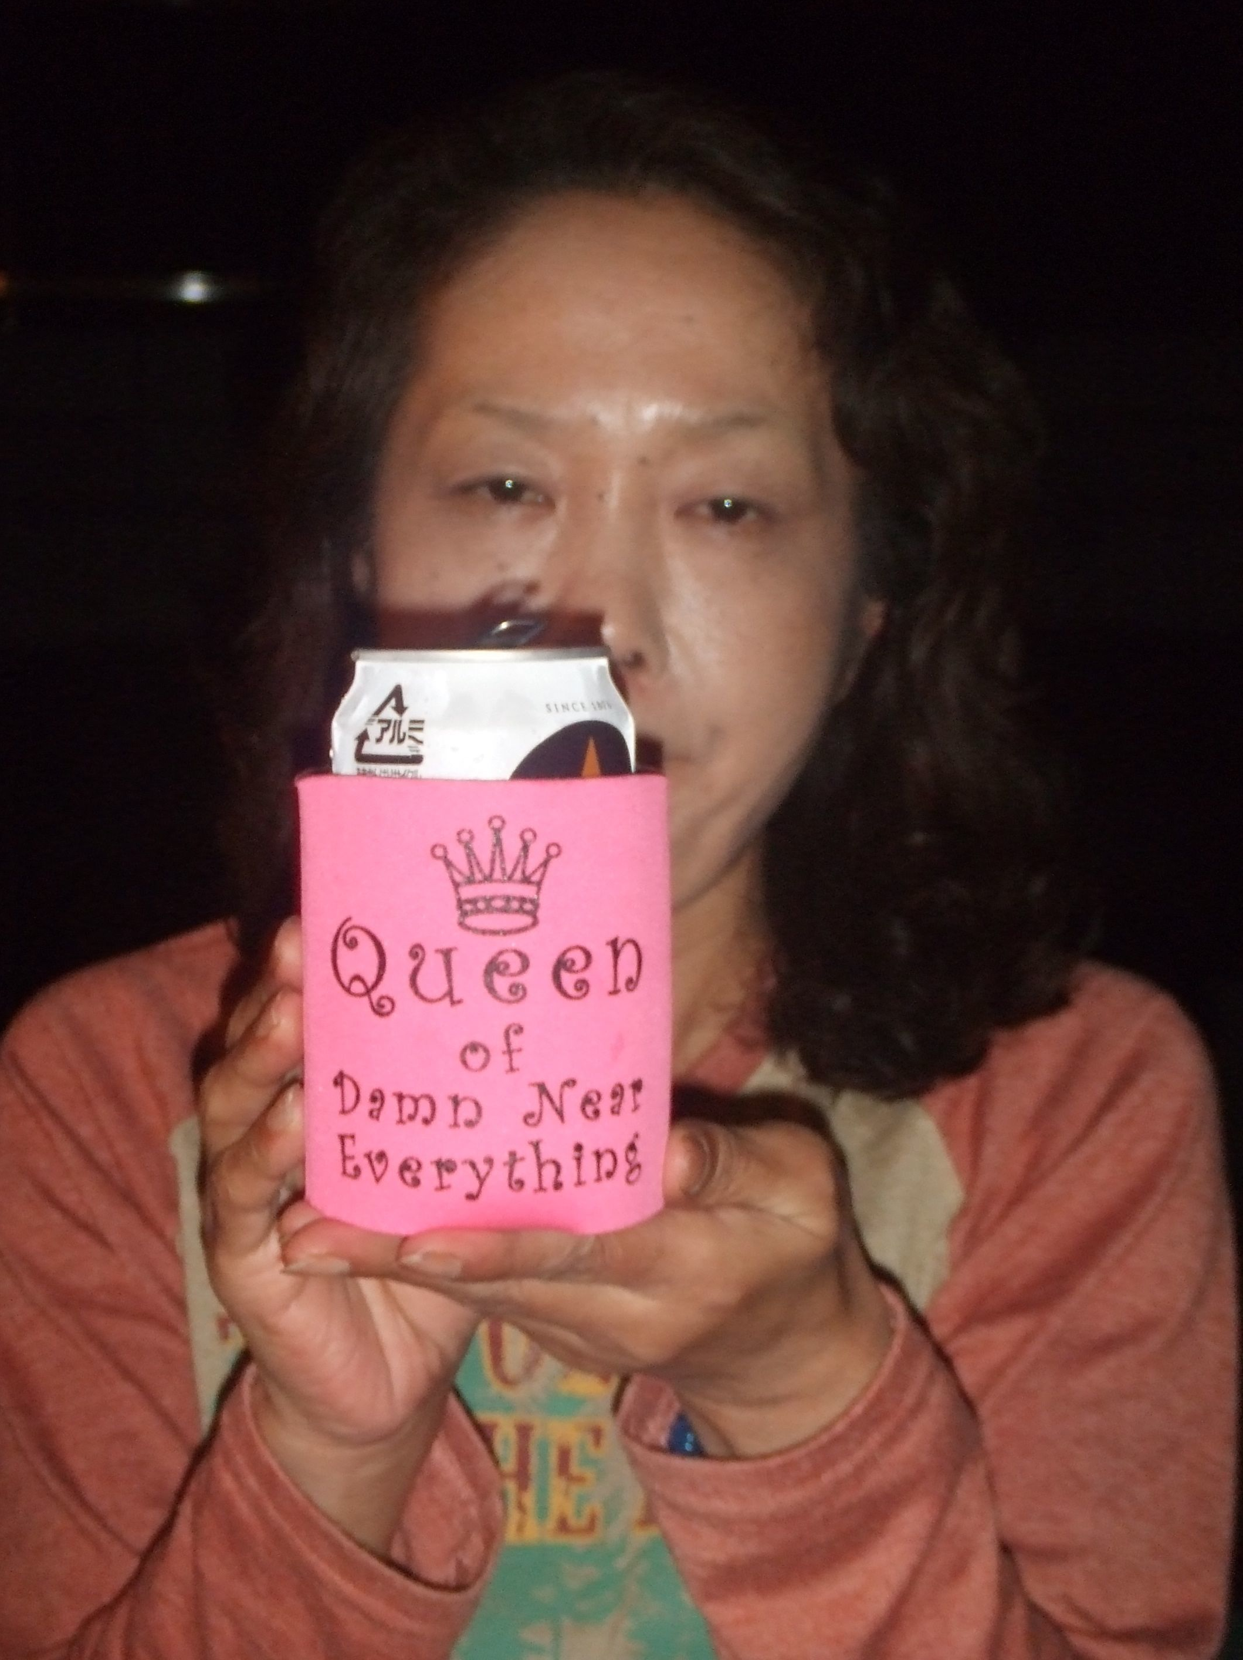
My
family:
This is
my wife
Masumi
Notes:
Fave person to bbq with/for.

Slide 7
5 pictures: Good things
in Marc’s life
Notes:
What would your pictures be?
Photo credit:http://propakistani.pk/2012/07/26/how-to-check-if-your-cell-phone-pictures-are-being-monitored/

